Slide 1
Planning for the Unexpected:
Manure Storage and Natural Disasters
Kevin Erb
University of Wisconsin – Madison
Division of Extension
kevin.erb@wisc.edu

Slide 2
Storage Issues - Solid
Spontaneous combustion (fire) – and the runoff from fire control.
Barn fires – and the runoff from fire control.
Floodwaters – ponding around stored manure in fields or dry lots

Slide 3
Storage Issues - Liquid
Overtopping storage (excess rain/flooding event) or poor management.
Barn fires – adding unexpected water to storage.
Structural failure – Cracks, rodents, construction errors / non-engineered modifications.

Slide 4
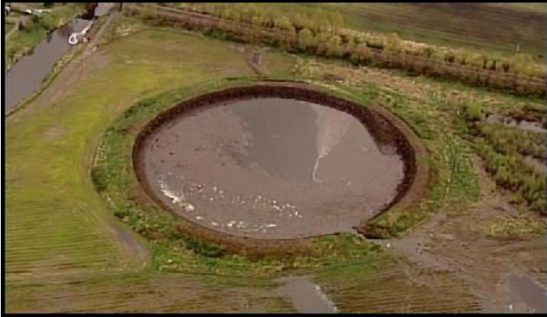
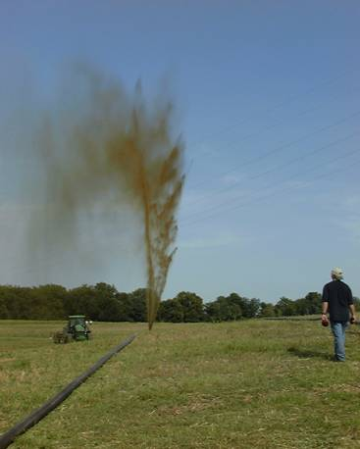
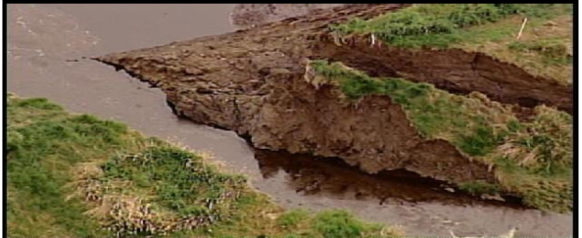
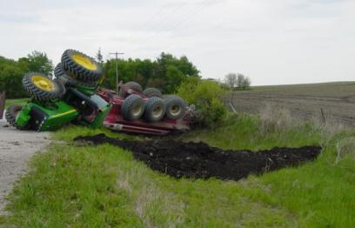
Iowa Summary
304 manure spills from within 10 yr (1992-2002)
Armstrong et al. 2010
Graphic: Armstrong et al 2001. Photos: UWEX, IA DNR, EPA

Slide 5
Wisconsin Summary
Ronk and Erb, 2010
Notes:
Farm includes all aspects of the manure handling system – reception pits, lots, manure storage, piping, pumps, etc. Land application includes incidents that occurred at the time of application and those that occurred later (as a result of rain, snowmelt, or ponding)

Slide 6
Wisconsin On-Farm Incidents
Top months for overflow: August, April
Ronk and Erb, 2010
Notes:
65%+ of the incidents involve how manure storage is handled and managed. Due to rounding, percentages may not add up to 100%

Slide 7
When do Storages Overflow?
Ronk and Erb, 2010, Stencil and Erb, 2015

Slide 8
Being Prepared
Determine what are the potential problems you could encounter
Create both a prevention strategy and a response plan for each one
Make sure everyone knows the plan

Slide 9
Example: Spontaneous Combustion-poultry manure
Determine what are the potential problems you could encounter
Create both a prevention strategy and a response plan for each one
Make sure everyone knows the plan
Photo: https://www.rootsimple.com/2014/10/compost-piles-on-fire/

Slide 10
Prevention Strategy
Manage pile sizes/airflow/moisture to reduce chances of spontaneous combustion
Site windrow (or barn if under-barn storage) away from water resources
Create a berm to contain/slow down runoff from fire fighting (BEFORE THE FIRE)

Slide 11
Response Plan
Think through the potential for a fire
  Where will the runoff water go?
  What are options to contain it?
  Where do I put it?

Slide 12
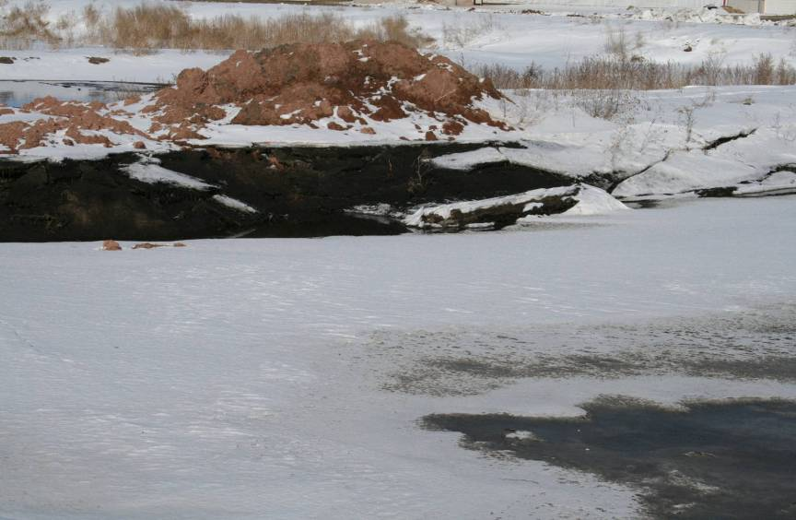
Example - Storage Leak:
300,000 gallons in 6 hours
Photo: https://www.rootsimple.com/2014/10/compost-piles-on-fire/
Photo: Kevin Erb, UW Extension

Slide 13
Situation
Construction around pit damaged a stormwater pipe running in storage berm
Pipe collapsed, releasing 300,000+ gallons of manure into road ditch/fields

Slide 14
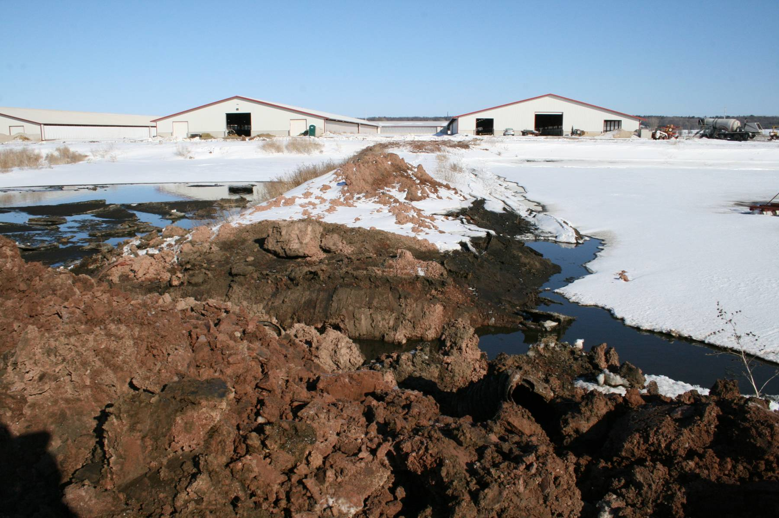
Notes:
Berm showing drop in south and rise in north pits.

Slide 15
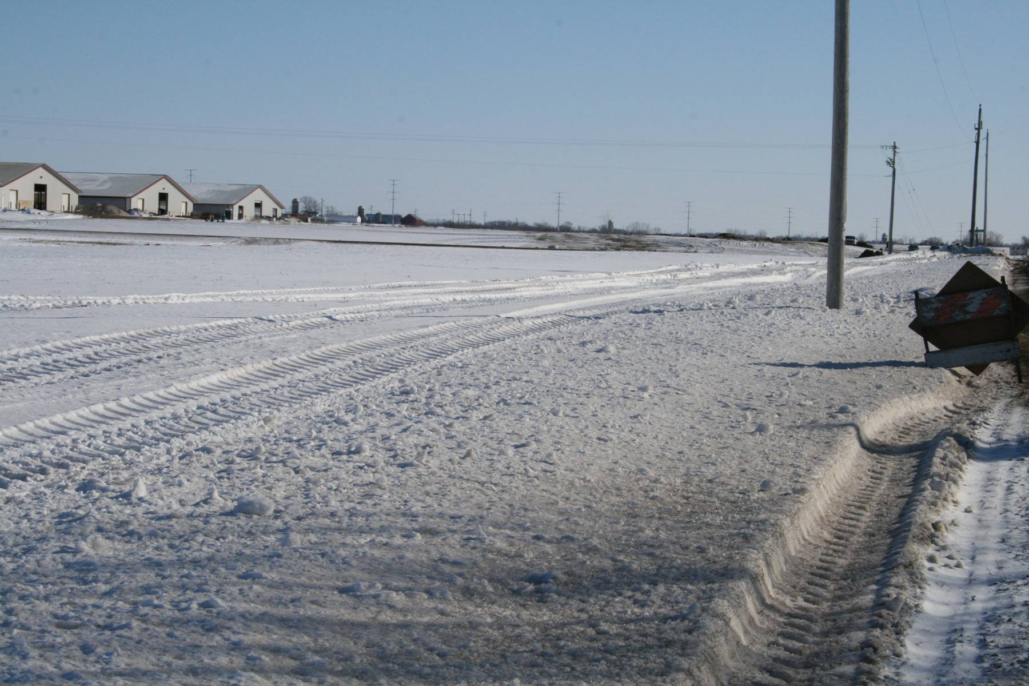
Notes:
Old 57 towards pit view.

Slide 16
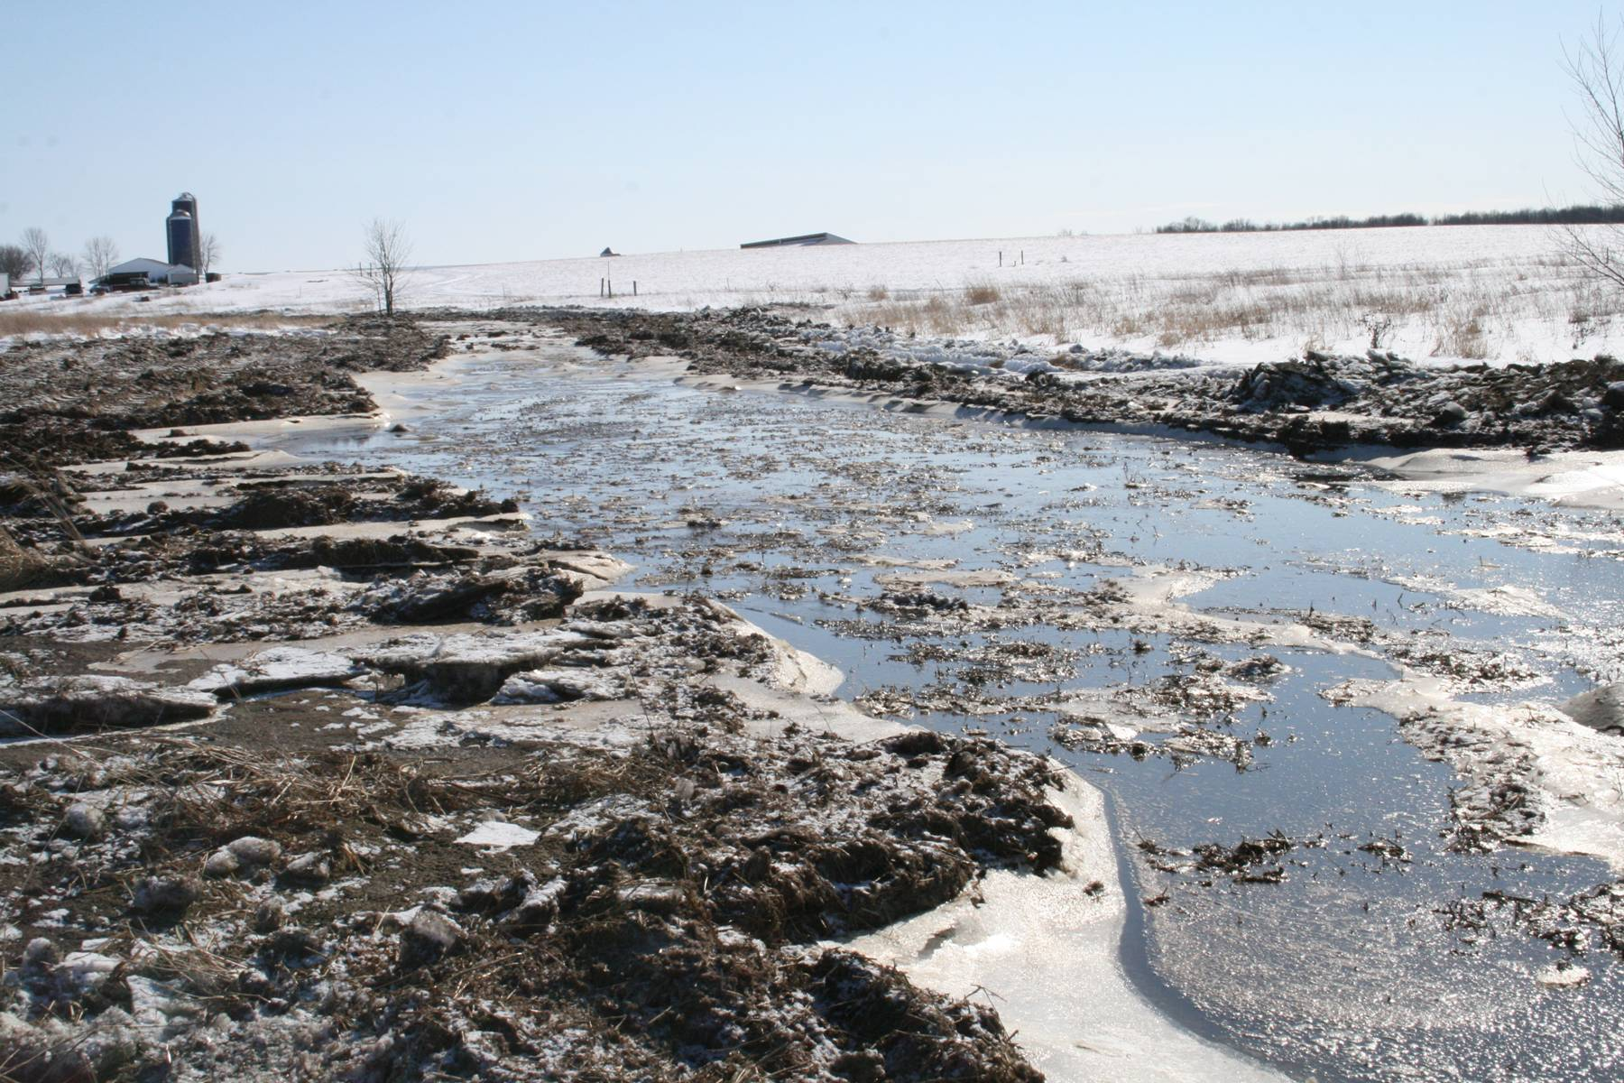
Notes:
Cleanup 3.

Slide 17
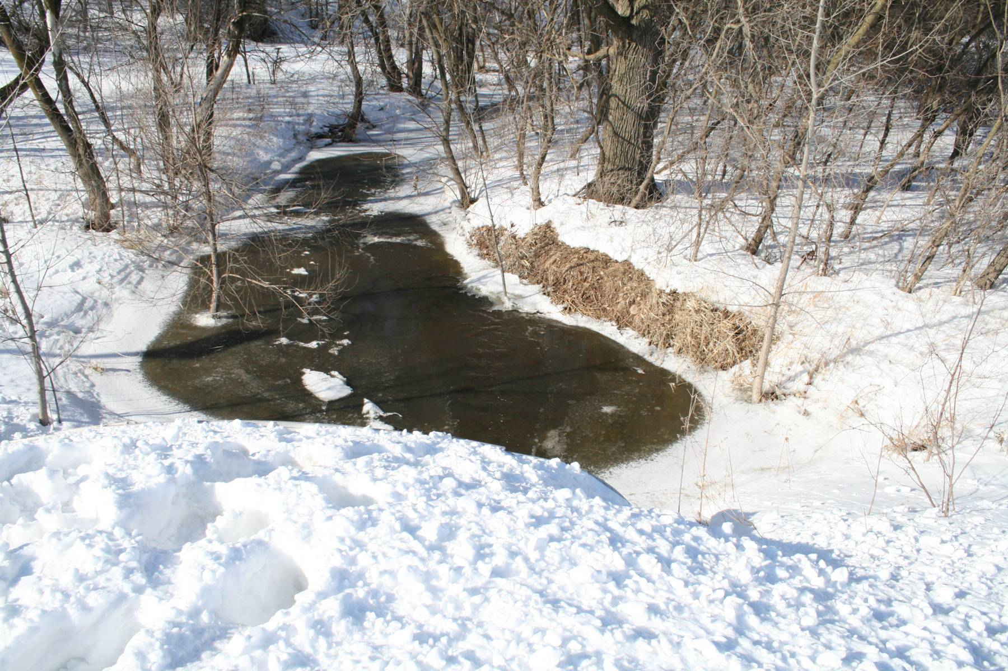
Notes:
East River trib Mill Road 2.

Slide 18
Prevention Strategy
Identify risks at time of construction—reroute stormwater pipes and drainage tile
The dangers of gravel backfill around pipes

Slide 19
Prevention Strategy
Work with a professional engineer when modifying storage
Secondary containment?

Slide 20
Response Plan
Think through the potential for leak caused by an unknown pipe or a rodent burrow
Where would it flow to? Where is the equipment to contain it? Can I access it quickly?
Where do I put the manure?

Slide 21
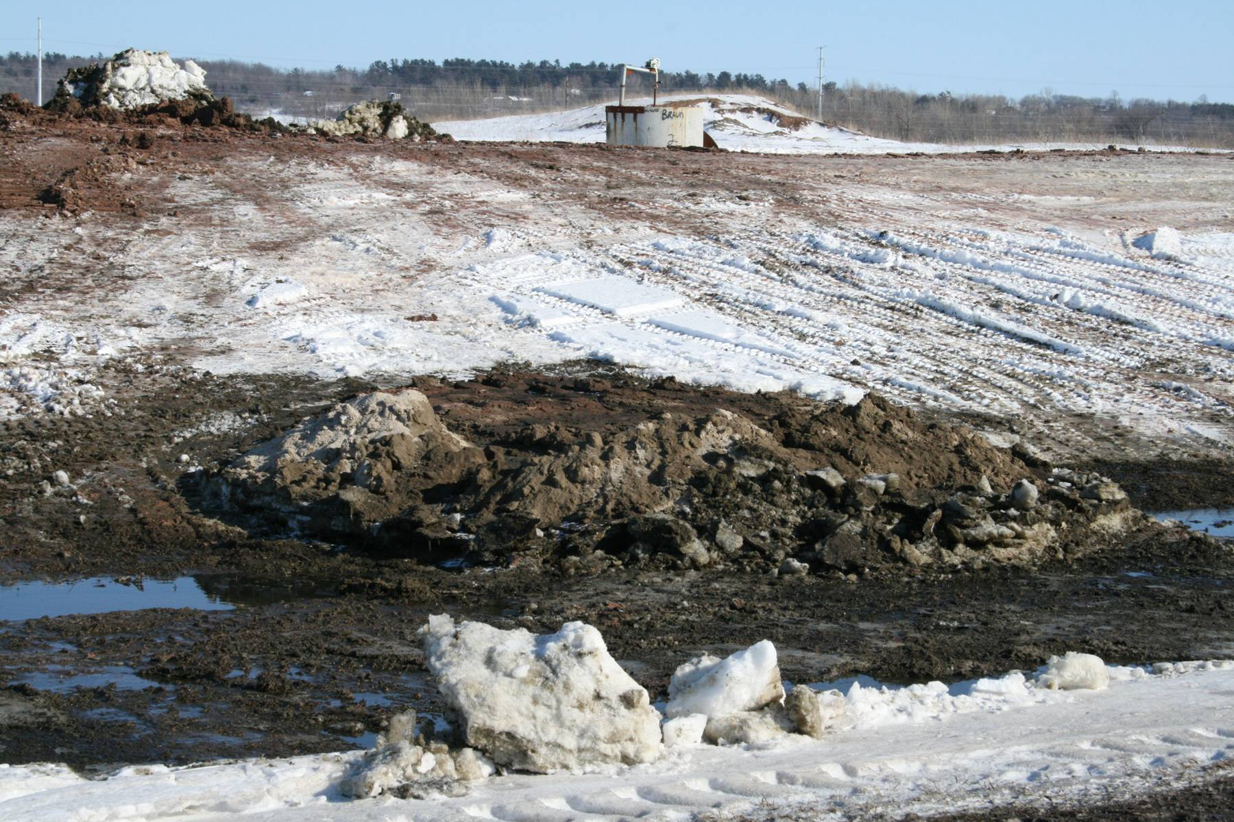
Photo: Kevin Erb, UW Extension
Notes:
Pipe plus roadditch at pit 2.

Slide 22
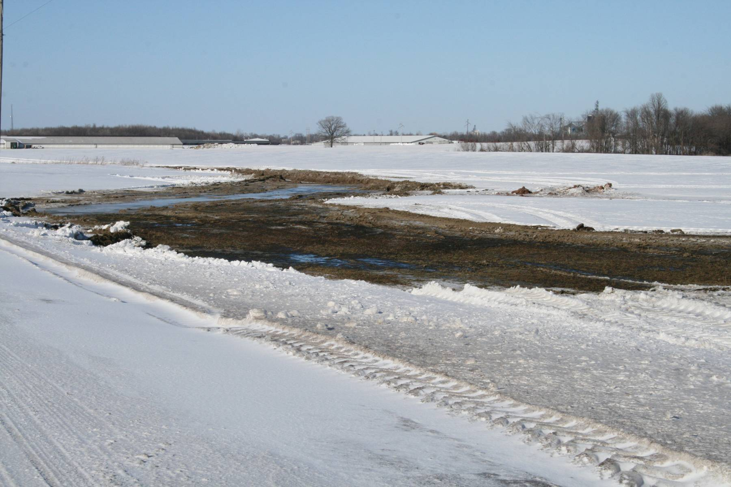
Photo: Kevin Erb, UW Extension
Notes:
Tent city turf 1.

Slide 23
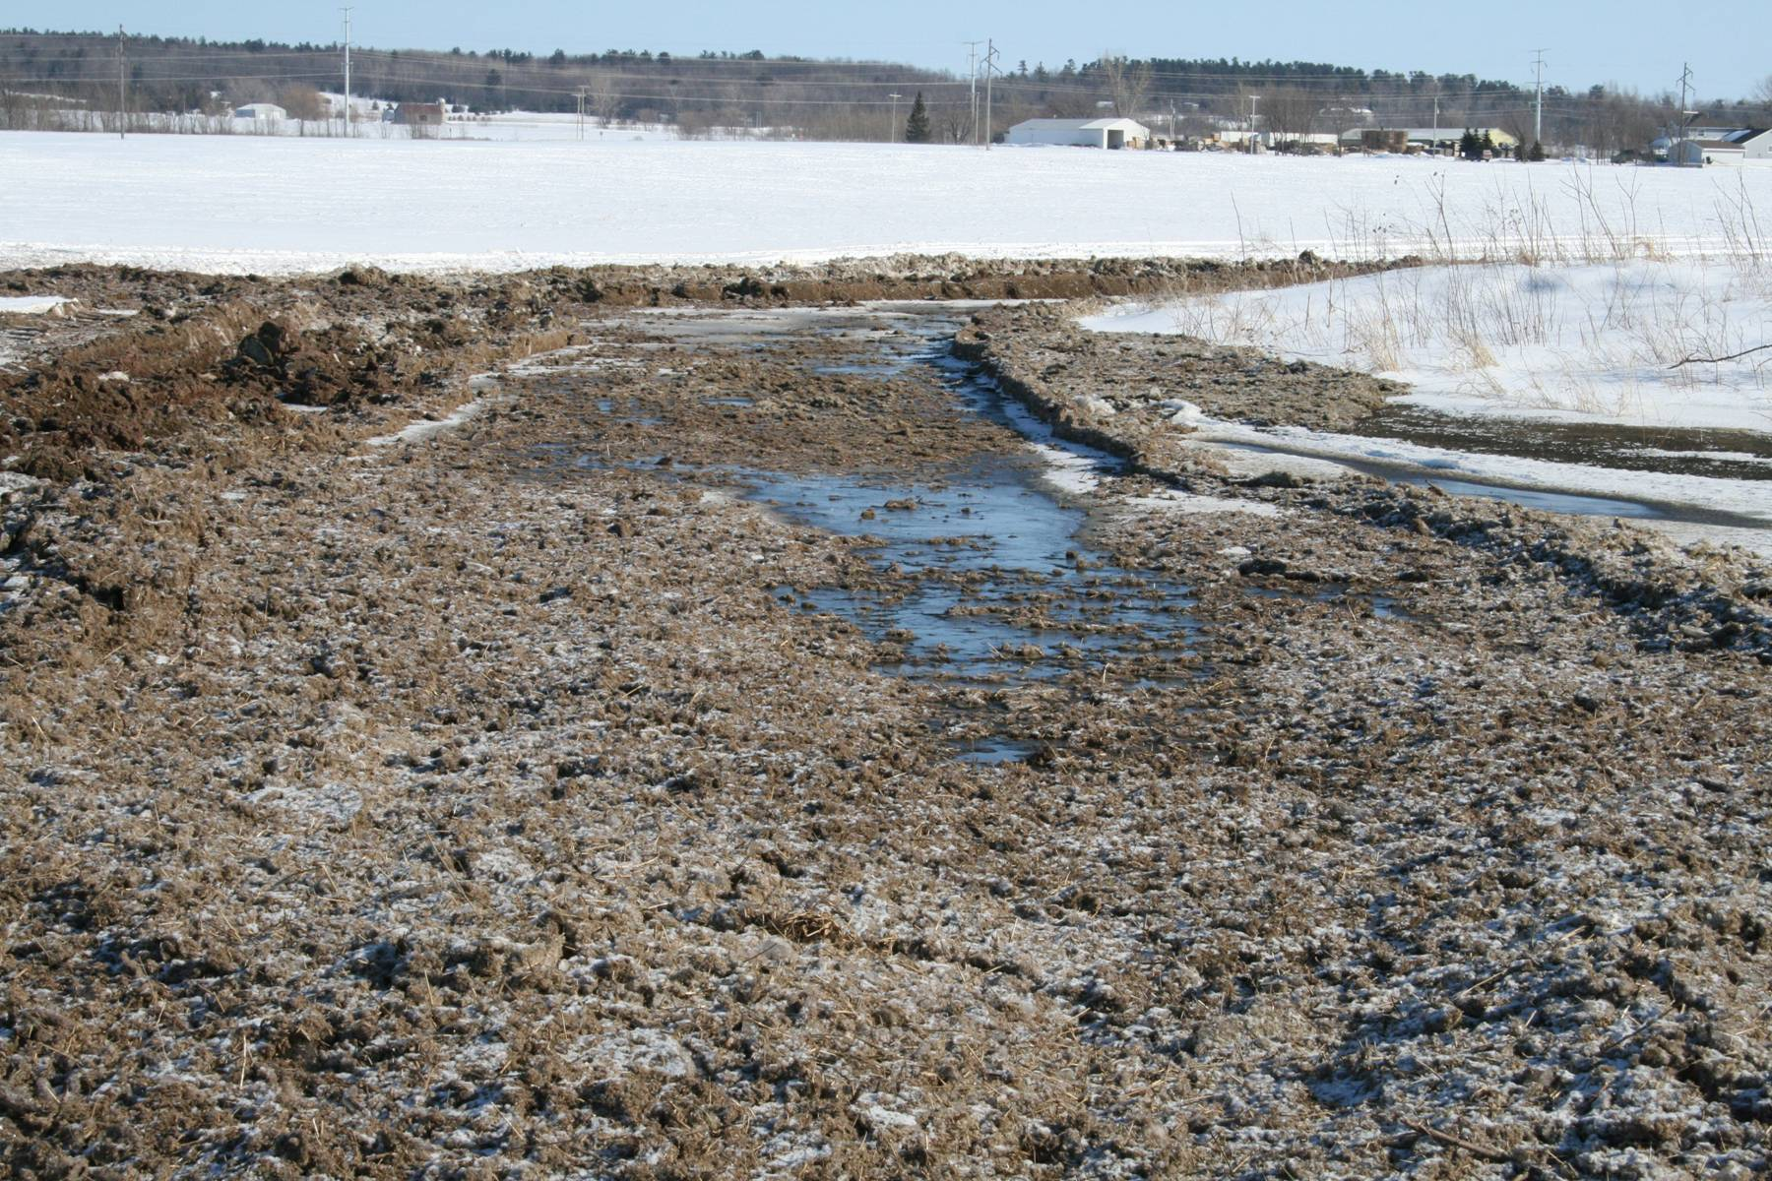
Photo: Kevin Erb, UW Extension
Notes:
Manure slushie 3.

Slide 24
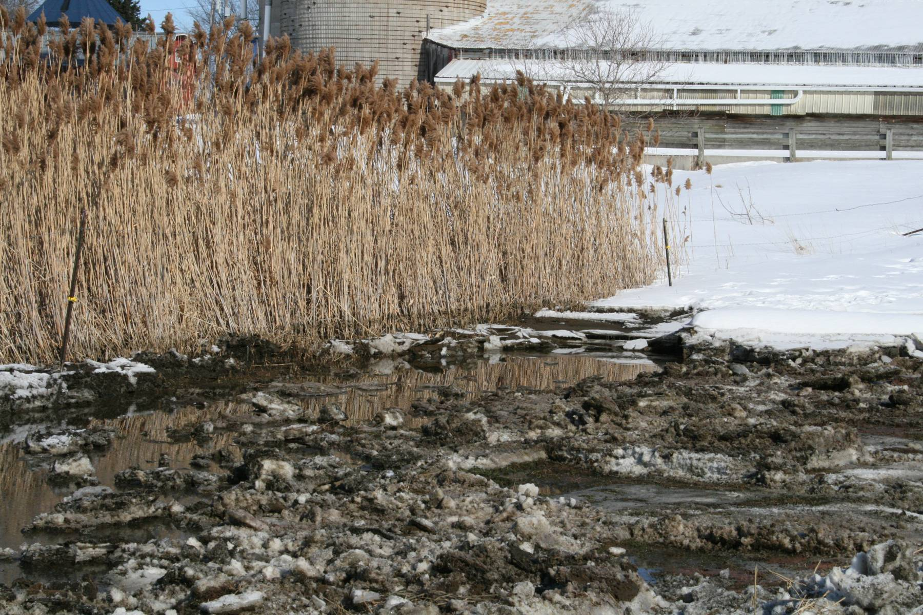
Photo: Kevin Erb, UW Extension
Notes:
Old 57 clean water trib damn 1.

Slide 25
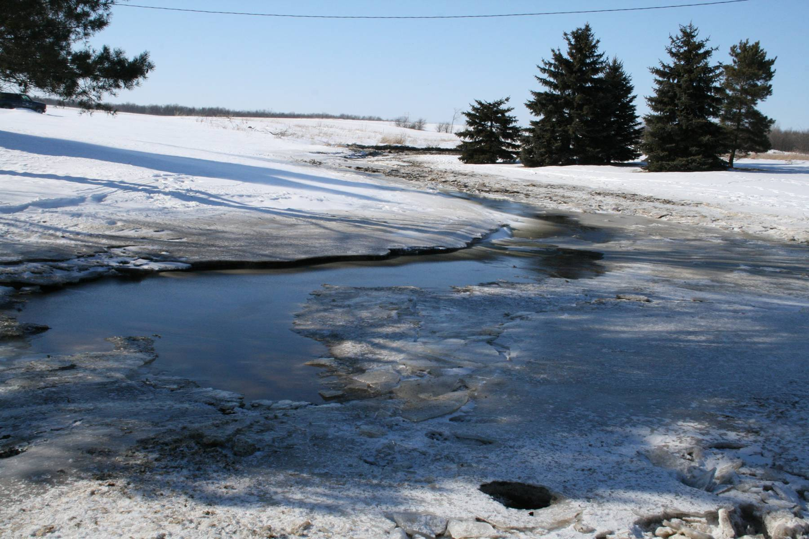
Photo: Kevin Erb, UW Extension
Notes:
Neighbors yard post fire department flush.

Slide 26
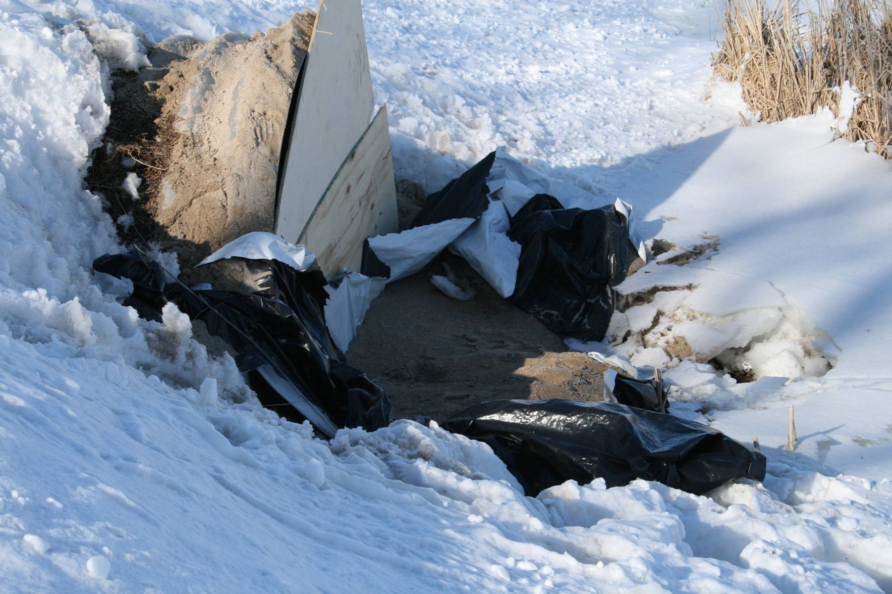
Photo: Kevin Erb, UW Extension
Notes:
Old 57 clean water trib damn 1.

Slide 27
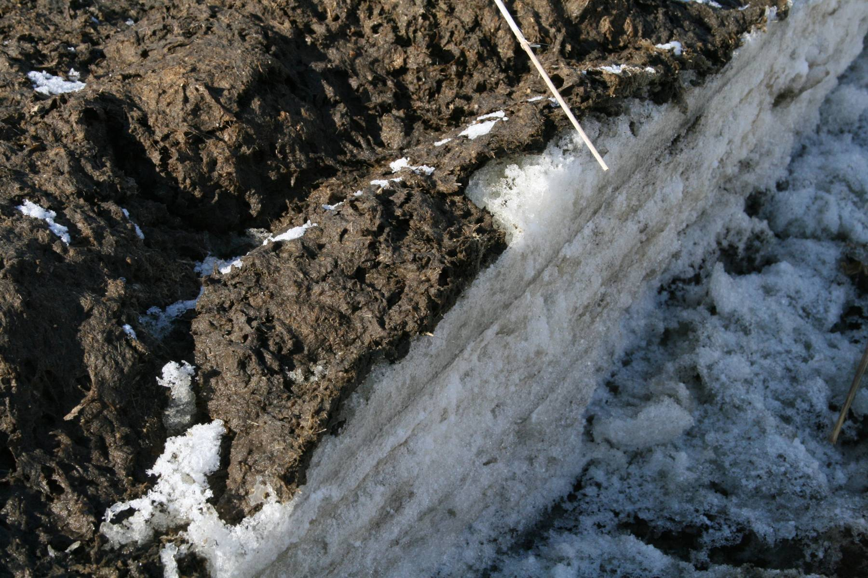
Photo: Kevin Erb, UW Extension
Notes:
Solids on snow 1.

Slide 28
Flooding – Solid
The longer water is in contact with manure, the more nutrient enriched the water becomes
Solid manure piles will leach for weeks after saturation

Slide 29
Flooding
Do not place manure stacks/storage in areas likely to flood
Keep storage several feet below design capacity to handle unexpected rains/delayed spreading
  For those in Tropical Storm areas, this may be 3-5 feet!
  Wisconsin – several 8+ inch rainfall events

Slide 30
Always have extra capacity – pump before you need to
Photos: ThinkProgress.org

Slide 31
Overtopping Storage
Do not “add a few feet of soil”
Find other designed/engineered storage in the neighborhood to use.
  Farms in the upper midwest are known to truck manure 80 miles ONE WAY in crisis situations.

Slide 32
Overtopping Storage
Municipal sewage treatment plants an option of last resort
Charge by the gallon and by the concentration of contaminants
  Don’t agitate - take the most diluted manure from the top, at the far corner of the storage from the inlet pipe

Slide 33
Fires
Divert, if possible, clean water from manure storage to avoid overfilling
Alert first responders and regulators to the fact that fire fighting actions may cause a secondary manure problem

Slide 34
What is your PREVENTION STRATEGY?

Slide 35
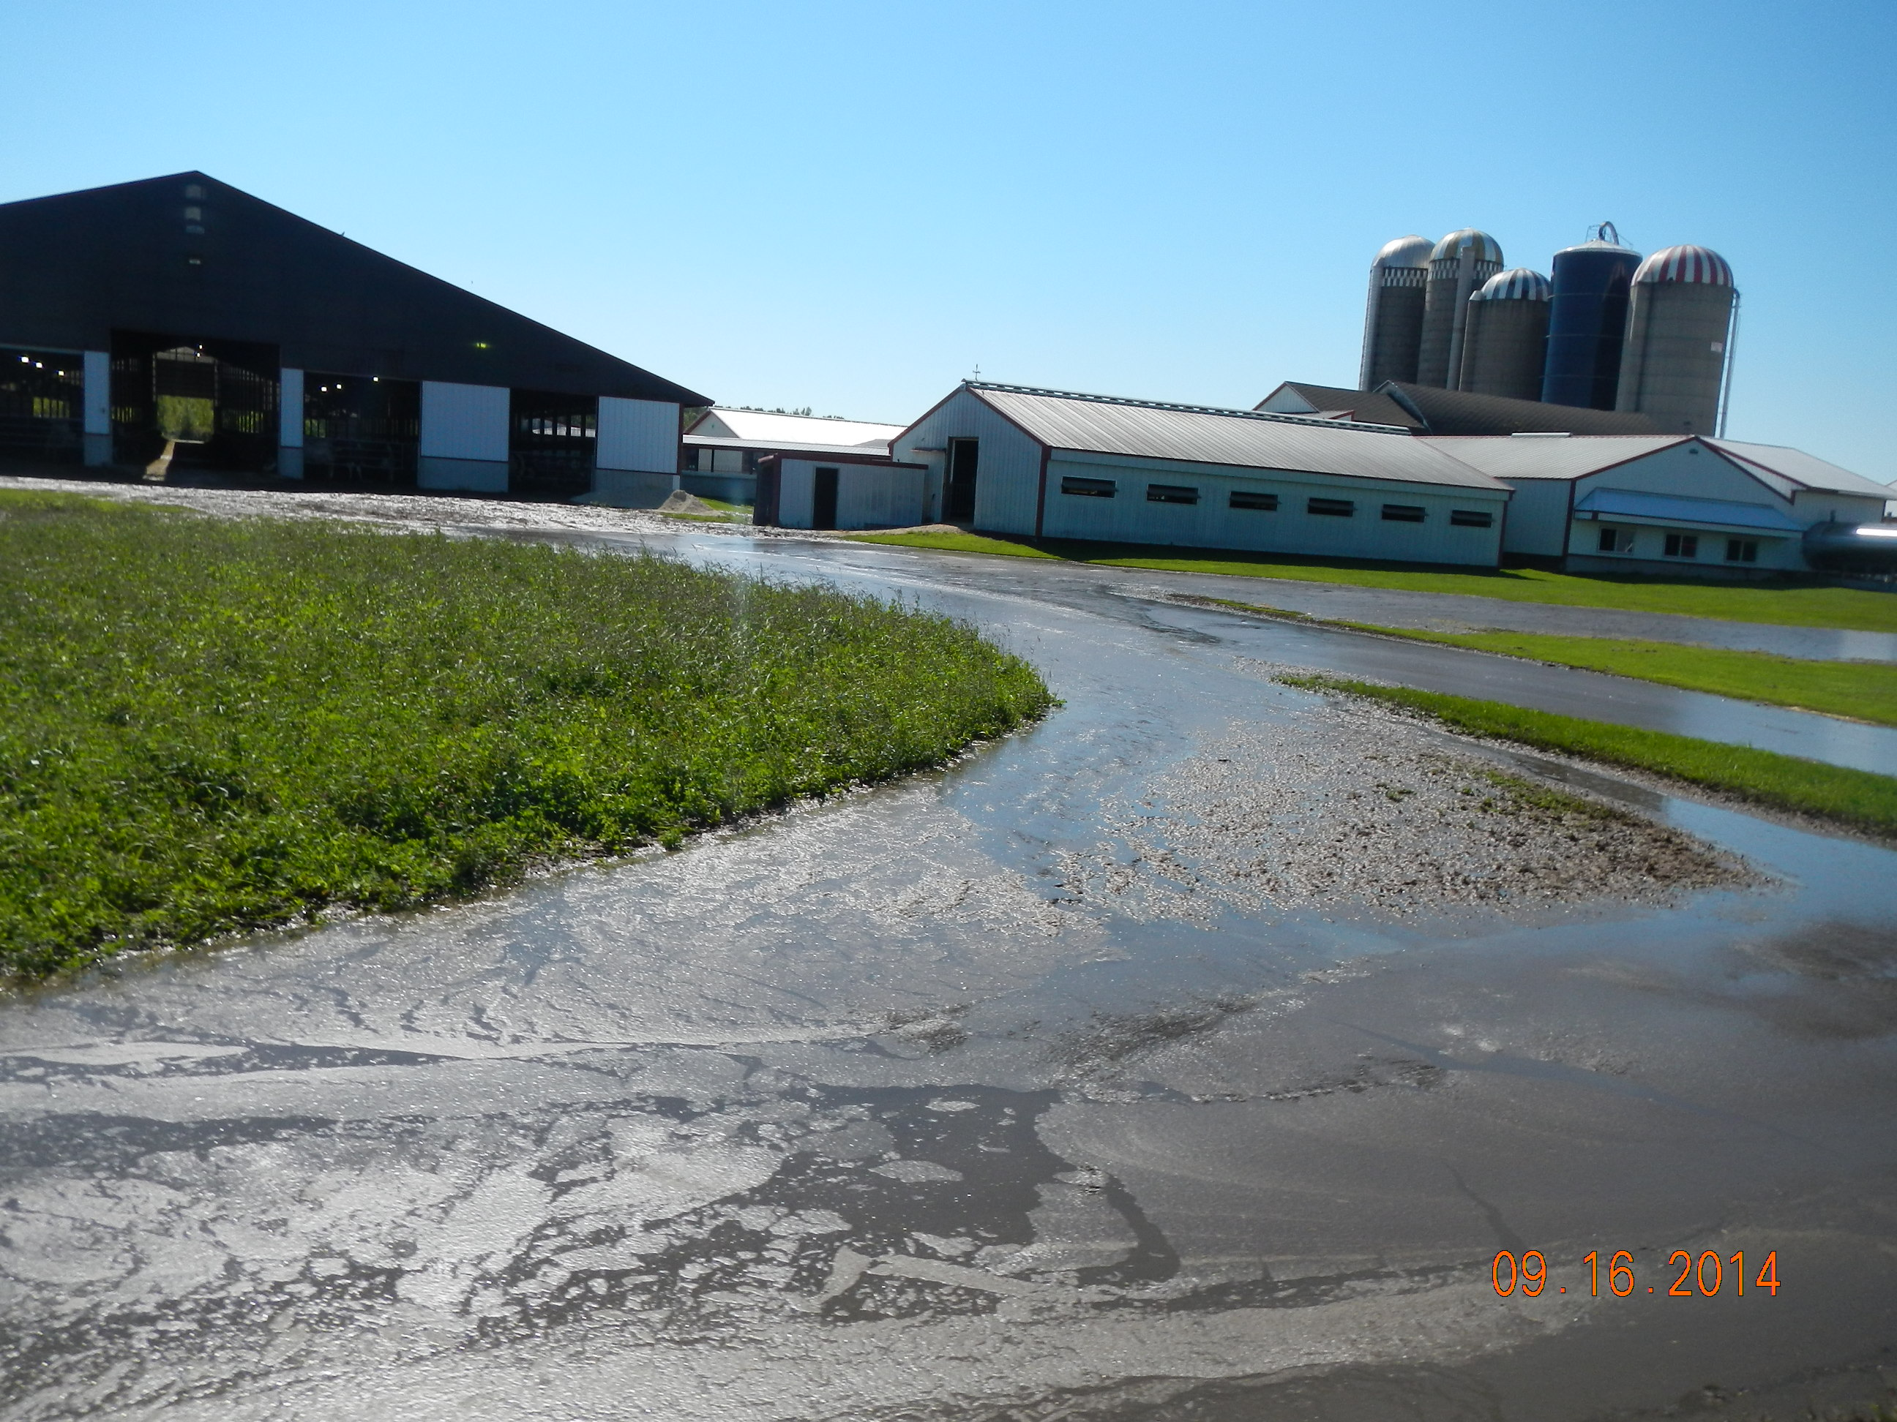
Photo Credit: Wisconsin DNR

Slide 36
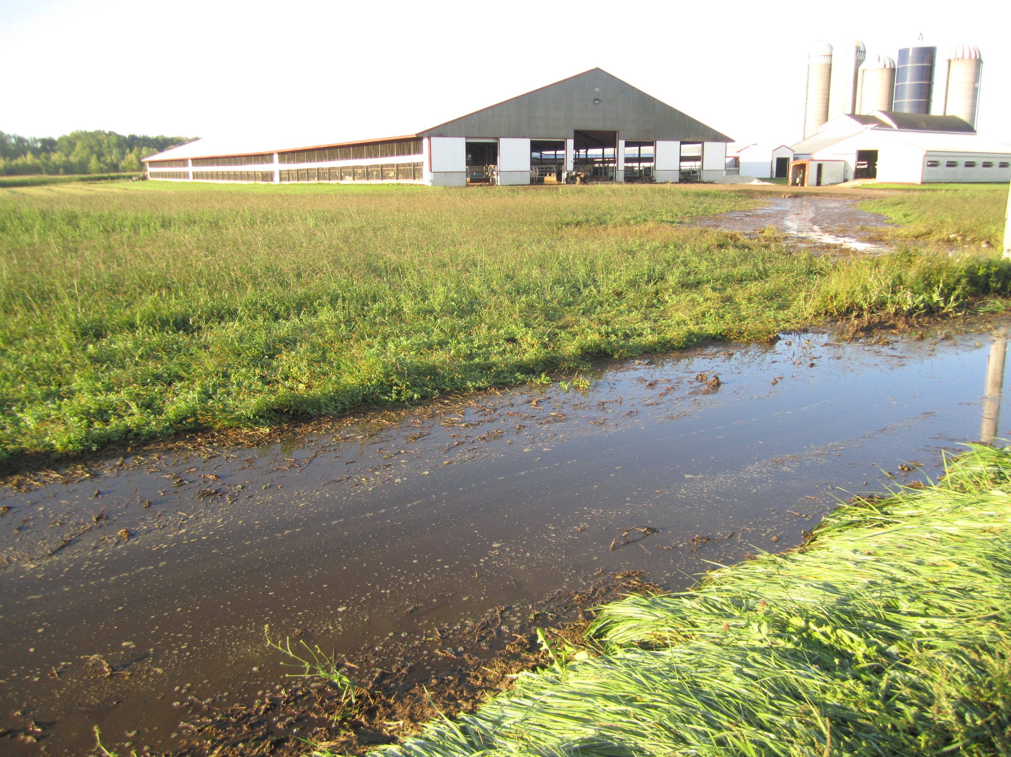
Photo: Kevin Erb, UW Extension

Slide 37
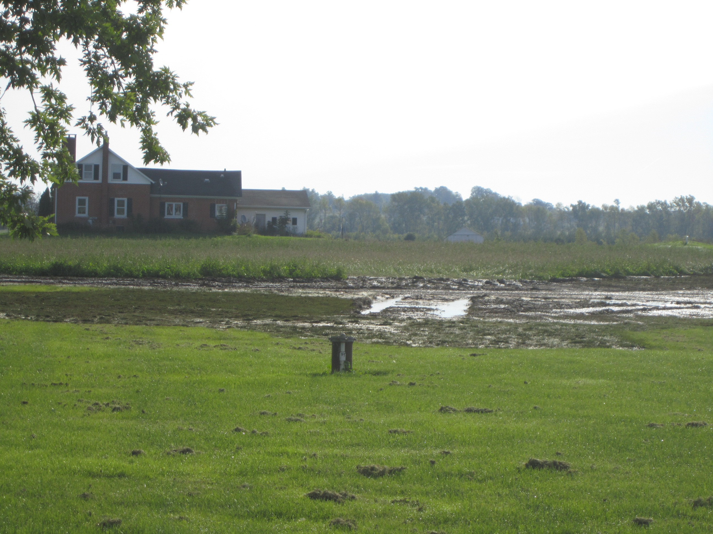

Slide 38
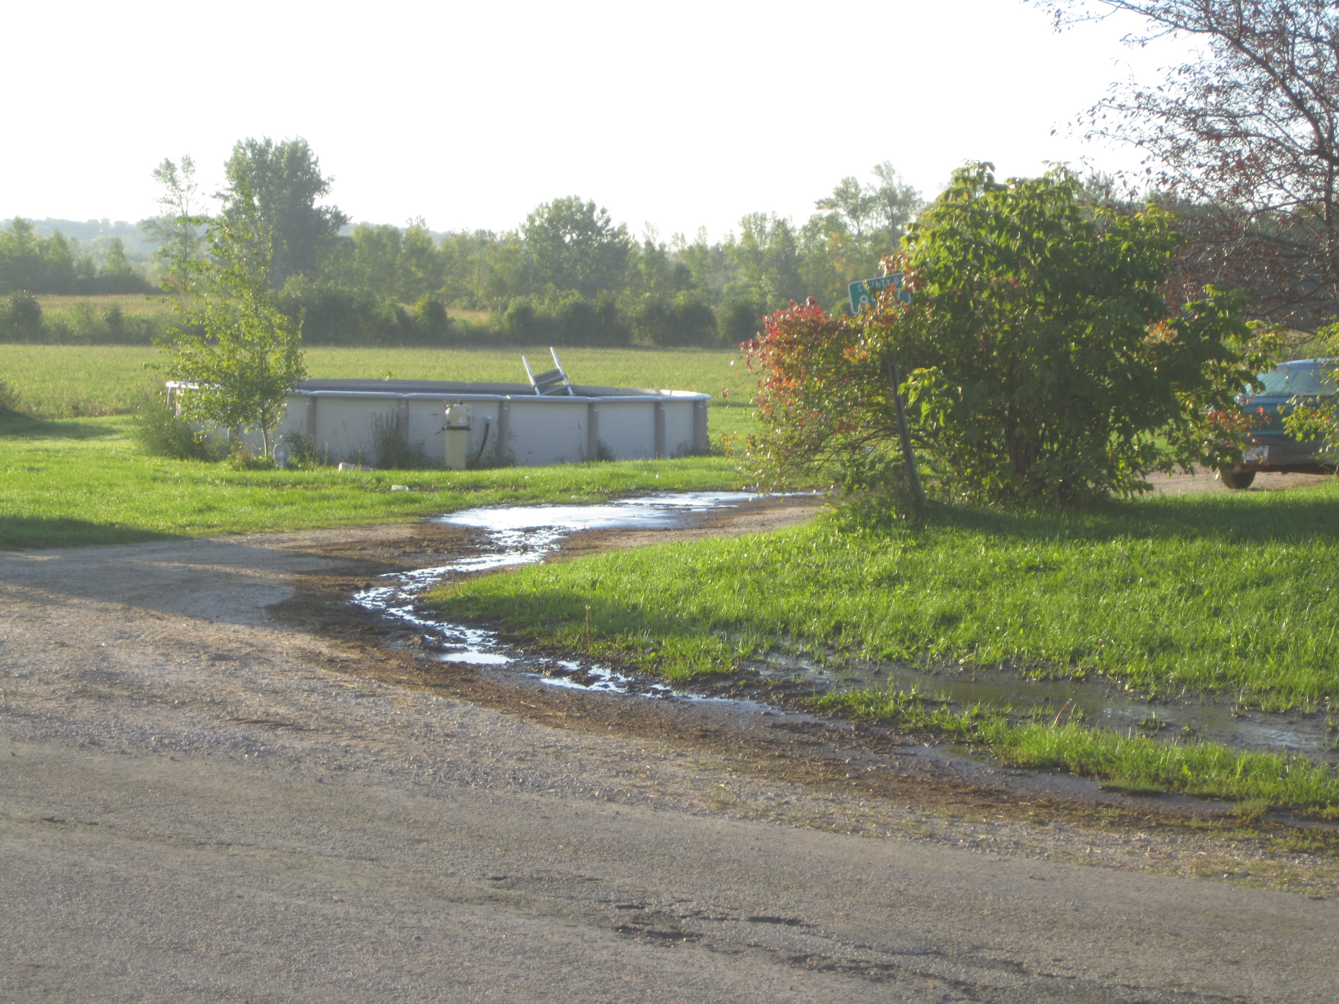

Slide 39
What is your RESPONSE PLAN ?

Slide 40
Summary
Consider all potential disaster causes
  Rain-delayed spreading/flooding of storage
  Fire response that causes runoff
  Spontaneous combustion
  Storage failure – engineering failure, pipe failure, rodent burrowing into earthen berm

Slide 41
Summary
Create both a prevention strategy and a response plan for each one
Make sure everyone knows the plan

Slide 42
Questions?
Kevin Erb
University of Wisconsin – Madison
Division of Extension
kevin.erb@wisc.edu

