Slide 1
Foundational Nutrient Concepts Everyone Utilizing Manure Should Know
2019 North American Manure Expo
Fair Oaks, Indiana
Robb Meinen
Penn State Department of Animal Science
119 ASI Building, University Park, PA 16802
rjm134@psu.edu
(814) 865-5968

Slide 2
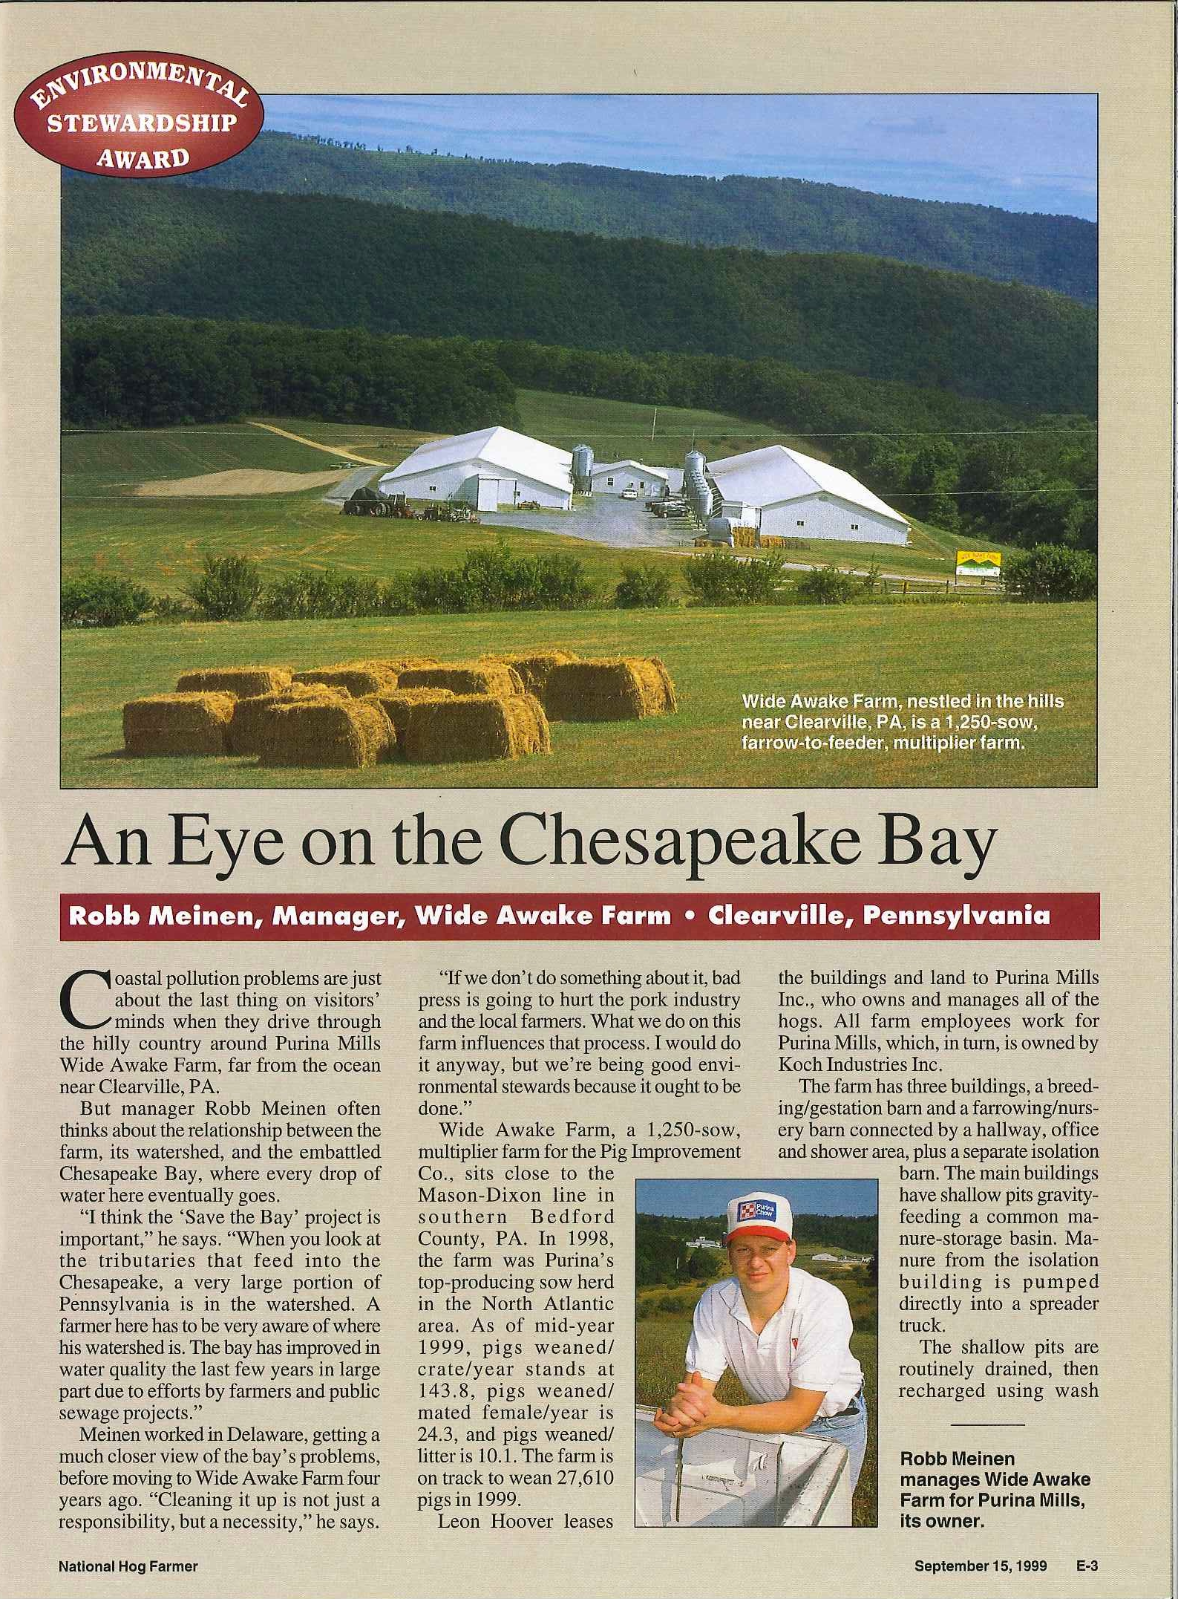

Slide 3
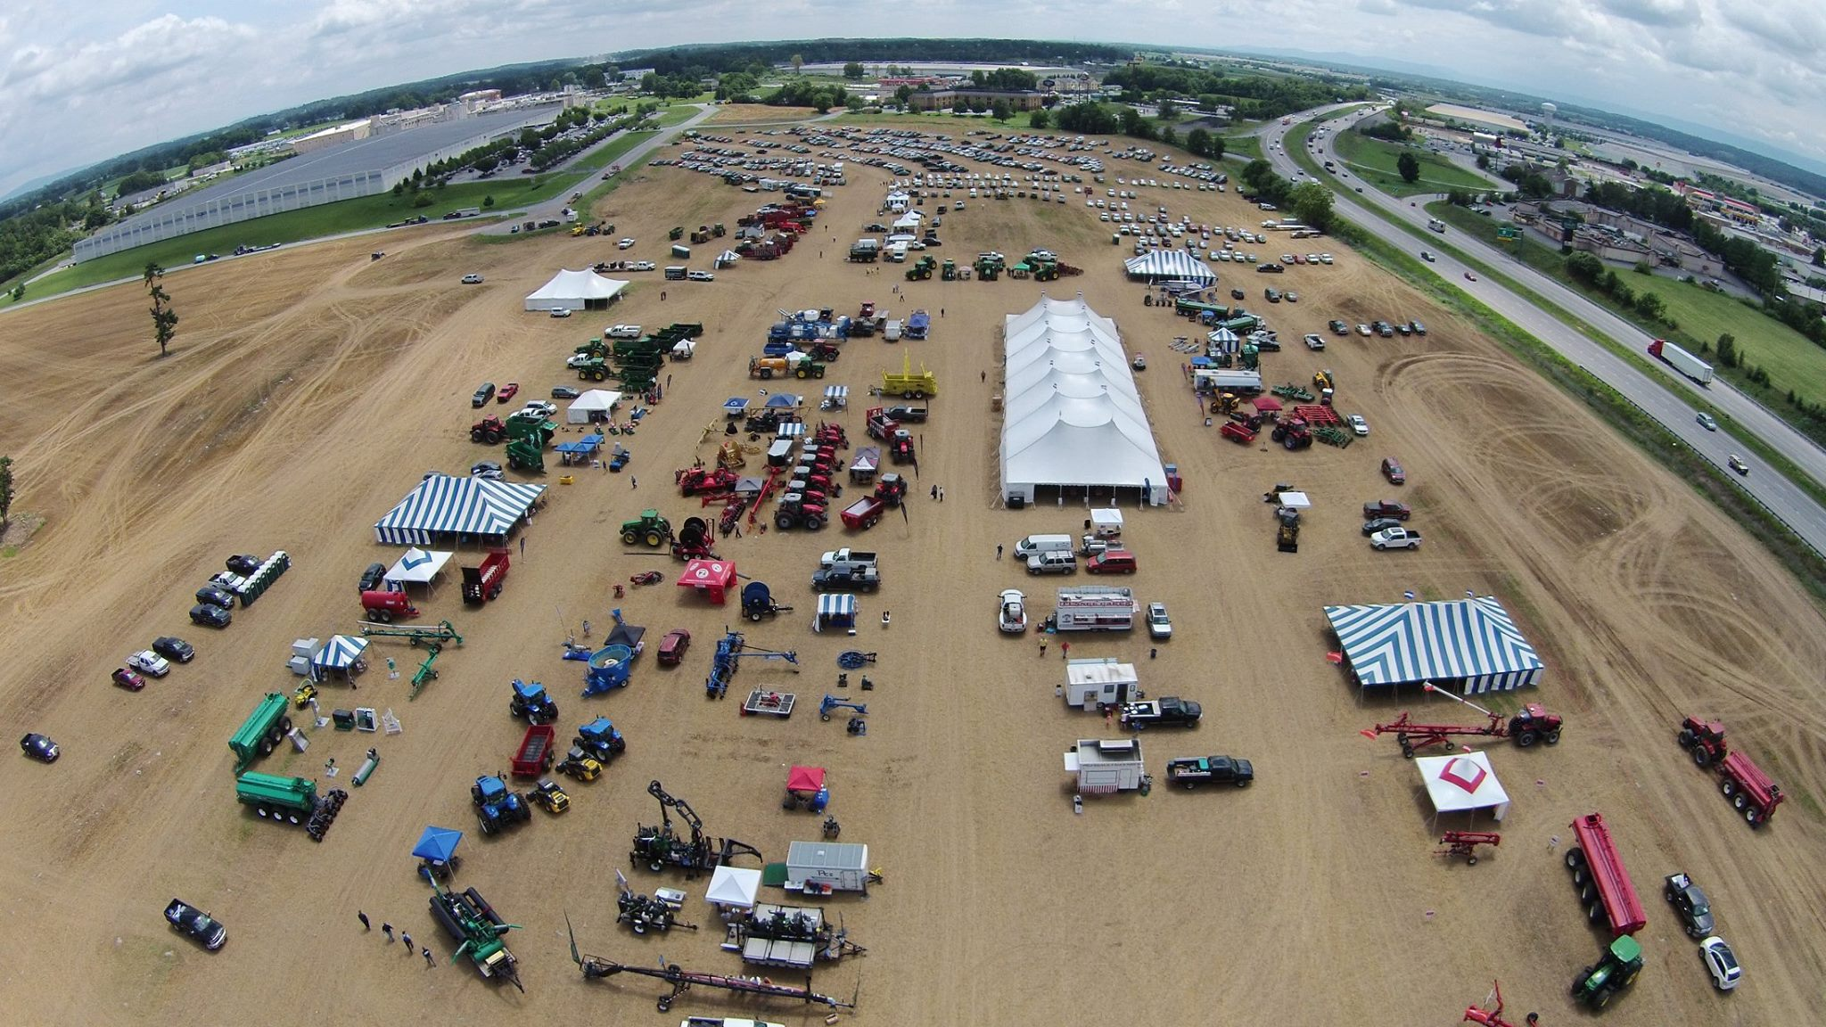

Slide 4
Manure Nitrogen Fractions
Total N
Soluble Mineral N
Readily available similar to urea fertilizer.
Susceptible to volatilization
Organic N
Must be broken down into mineral forms before it is available
Rule of thumb is that manure is 50/50 between these forms.
Shown on manure test as Ammonium N & Organic N

Slide 5


Nitrogen Cycle
Total N
Soluble Mineral N
Organic N
N₂
Crop Removal
Fertilizer
Biological
Fixation
NH₃
Animal
Manure
N₂, N₂O, NO
Volatilization
Crop
Residues
Crop
Uptake
High pH
Microbes
Mineralization
Denitrification
NH₄⁺
Immobilization
Organic Matter
Nitrification
NO₃⁻
Leaching
Notes:
1

Slide 6
Where we want N to go
Plant Available N
NH₄⁺ - ammonium
NO₃⁻ - nitrate
N₂
Crop Removal
Fertilizer
Biological
Fixation
NH₃
Animal
Manure
N₂, N₂O, NO
Volatilization
Crop
Residues
Crop
Uptake
High pH
Microbes
Denitrification
Mineralization
NH₄⁺
Immobilization
Organic Matter
Nitrification
NO₃⁻
Leaching
These forms are mineral and soluble.
Notes:
1

Slide 7
N Removal, Loss & Immobilization
N₂
Crop Removal
Fertilizer
Biological
Fixation
NH₃
Animal
Manure
N₂, N₂O, NO
Volatilization
Crop
Residues
Crop
Uptake
Runoff
High pH
Microbes
Denitrification
Mineralization
NH₄⁺
Immobilization
Organic Matter
Nitrification
NO₃⁻
Leaching
Notes:
1

Slide 8
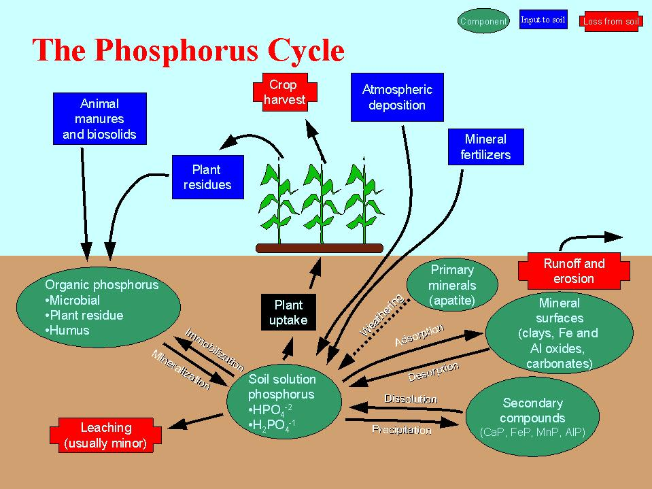
P Cycle
Centers around soil solution
Phosphorus Behavior and Management

Slide 9
Plant Available P
Microbes convert organic P to mineral forms
Only soluble inorganic P forms are plant-available
Most plant available are
  Orthophosphate ions
  H₂PO₄⁻
  H₂PO₄²⁻
  <1% of total P

Slide 10
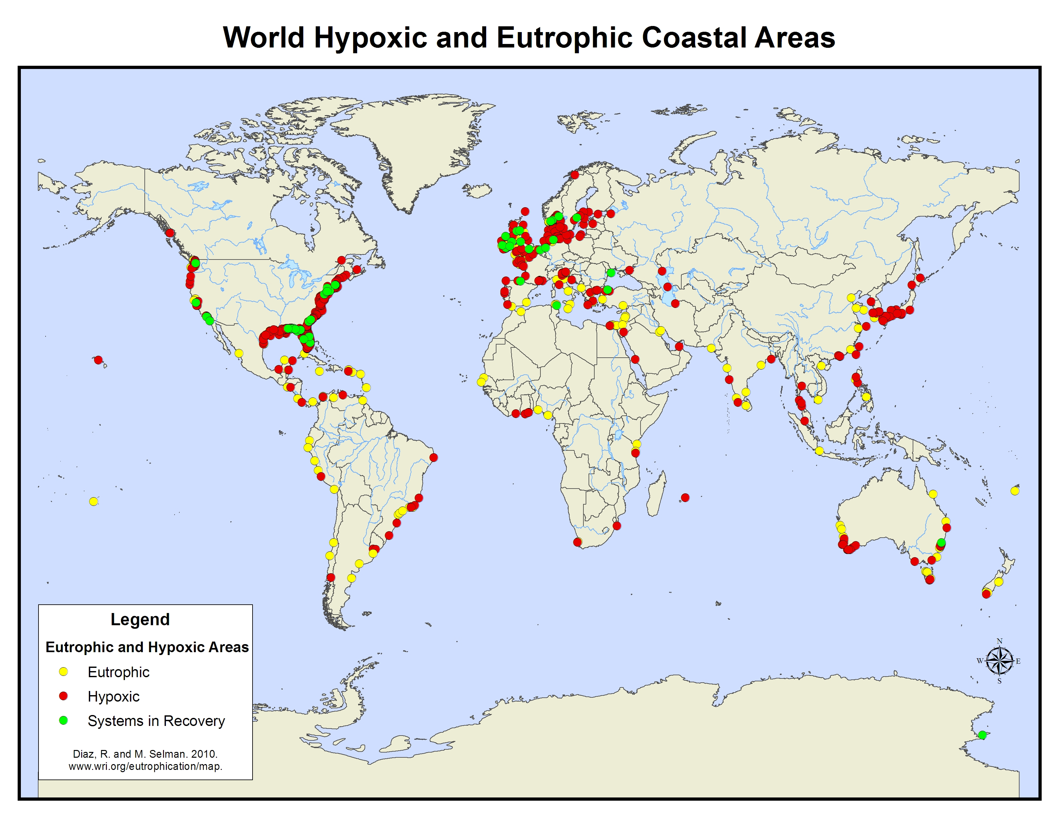
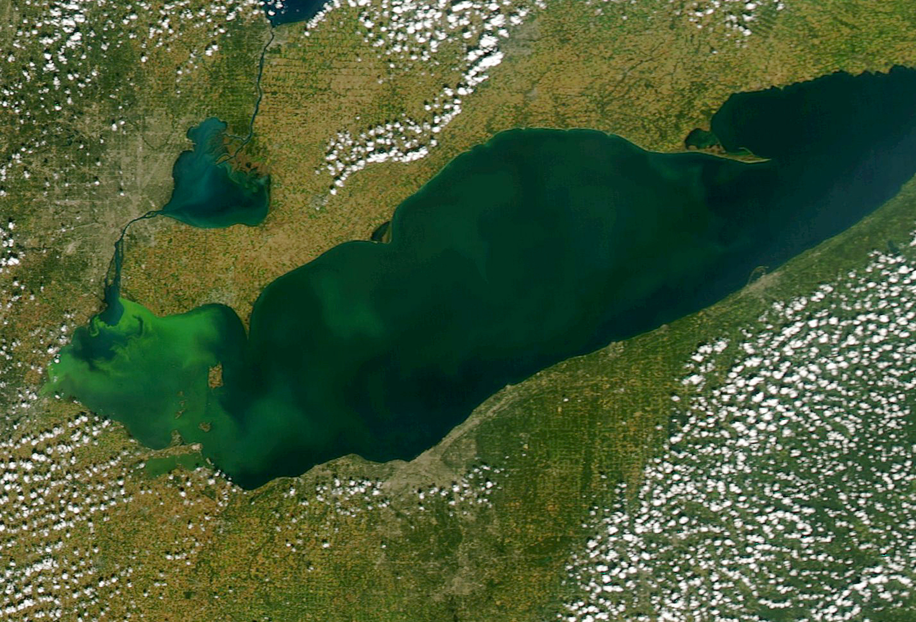
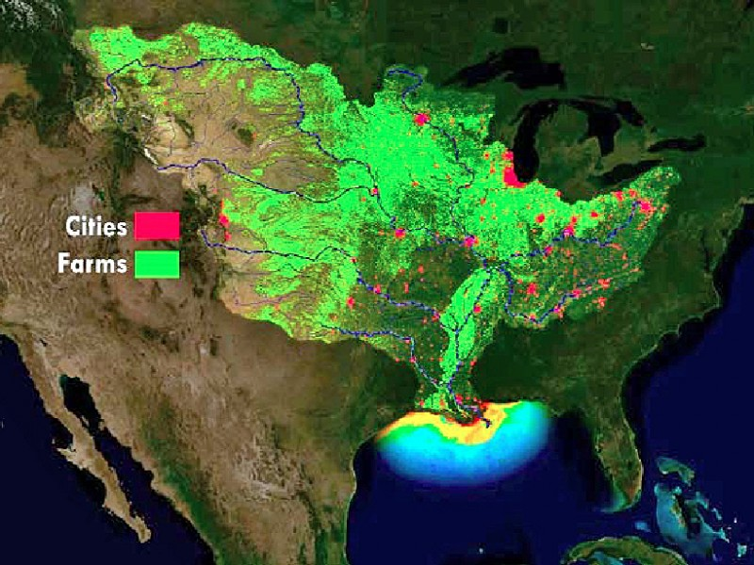

Impacts from one corn row can contribute to issues on many scales

Slide 11
1. N & P imbalances in manures
Corn Nutrient Requirement
Dairy Manure Nutrient Content
Nitrogen Balance
Corn/Dairy Manure
Phosphorus Balance
Corn/Dairy Manure
N
P₂O₅
K₂O
N
P₂O₅
K₂O
P Based Rates Require:
  2 to 4 times as much land to apply manure
  Purchase of nitrogen fertilizer
Notes:
6

Slide 12
e.g. Forms of P can change with Manure Source
2. Nutrient Sources have Variation
Runoff P concentration within 24 hours of applying 100 lb P2O5/acre using fertilizer (DAP), beef, poultry, or swine manure without incorporation into the soil (averages across 21 Iowa fields). Source: Mallarino and Haq, November 25, 2009, Iowa State University,2009, Agronomy Extension Soil Fertility Web Site.

Slide 13
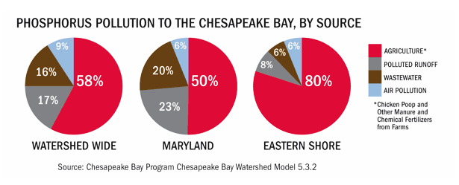
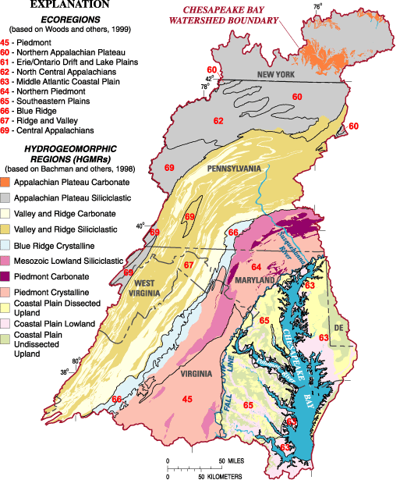
3. Variation of Nutrient Delivery
Factors contributing to nutrient loss vary widely. For example:
geographic regions
soil type
topography,
drainage
slope
conservation measures
Climate
Temperature
Etc, etc, etc.
Source: USGS

Slide 14
4. Natural Processes are Important for Nutrient Cycling and Utilization
N₂
Crop Removal
Fertilizer
Biological
Fixation
NH₃
Animal
Manure
N₂, N₂O, NO
Volatilization
Crop
Residues
Crop
Uptake
High pH
Microbes
Mineralization
Denitrification
NH₄⁺
Immobilization
Organic Matter
Nitrification
NO₃⁻
Leaching
Weather and microbial processes are drivers of the N-cycle
Notes:
1

Slide 15
5. Timing is important
N or Manure Application
Poor/OK
OK
Better
Best
Cover
Poorest
Poor
Better
Best
No Cover
Rain
Temp
Corn Growth
40º
40º
Cover Crop
Cover Crop
Nov
Jan
Mar
May
July
Sept
Time

Slide 16
6. Placement is Important
Proper placement of the nutrient source can limit risk of transport.
Work to keep nutrients where you place them!
Critical Source Area
High
Source
High
Transport
Sources
Transport
Soil
Fertilizer
Manure
Erosion
Runoff
Leaching
Volatilization
N P K
Runoff
Erosion
Leaching
Water Body
Ground Water

Slide 17
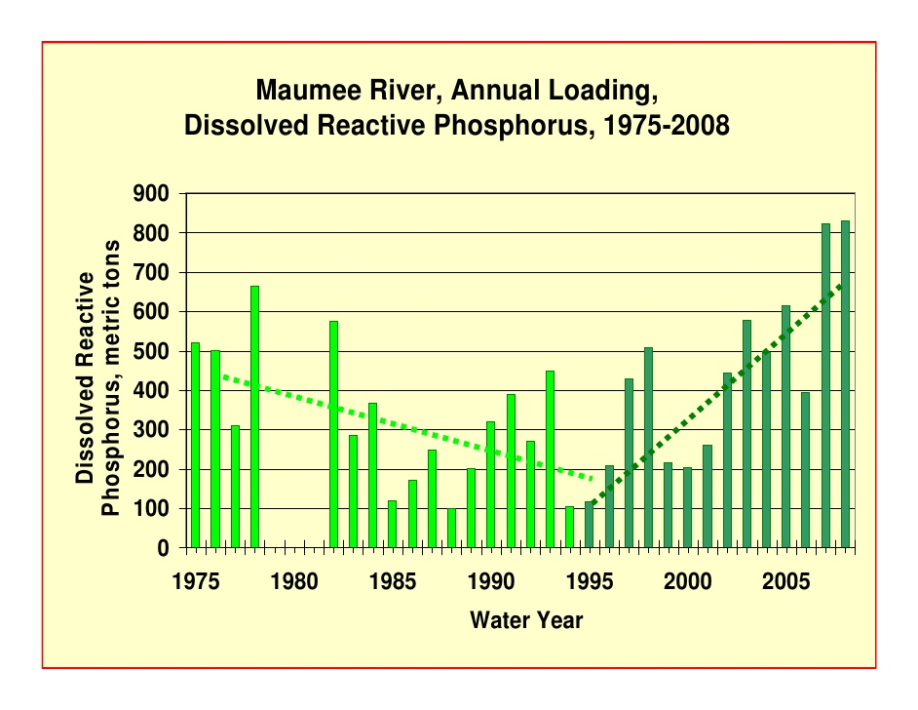
7. Dissolved P is necessary but...
understanding & management are necessary too
Often when you correct one environmental issue a tradeoff occurs elsewhere.

Slide 18
8. Lower rates can increase plant response and limit risk of nutrient loss
General Characteristics of Response Curves
2- Nutrient limiting
Nutrient not limiting
(some other factor limiting)
R₄
R₃
F₄
F₃
Non-responsive Range
R₂
Plant Response
F₂
R₁
3 - Responsive Range
1 - Critical Level
F₁ = F₂ = F₃ = F₄
R₁ > R₂ > R₃ > R₄
F₁
Growth Factor (Nutrient)

Slide 19
Soil Test Recommendations
9. Soil test interpretation allows for maximum production while limiting risk of loss.
Yield
Critical Level
Plant Response
Deficient/
Low/ Below Optimum
Sufficient/Optimum
High/ Above Optimum
Excess/
Toxic
Growth Factor

Slide 20



10. Soil Health is So Important
Soil Health
The ability of a soil to provide for crop growth and other environmental services
More than just nutrient levels!
Organic Matter
Organic matter and living plants are the keys to soil health
Physical
Biological
Chemical
Organic Matter
Organic Matter
Organic Matter
Bulk Density
Aggregate Stability
Mycorrhizal Fungi
Soil Strength
CEC
Disease Suppression
Microbial Respiration
Nutrient Cycling
pH

Slide 21
Immobilization the often forgotten – but very important component of the N-cycle
N₂
Crop Removal
Fertilizer
Biological
Fixation
NH₃
Animal
Manure
N₂, N₂O, NO
Volatilization
Crop
Residues
Crop
Uptake
High pH
Microbes
Denitrification
Mineralization
NH₄⁺
Immobilization
Organic Matter
Nitrification
NO₃⁻
Leaching
Notes:
1

Slide 22
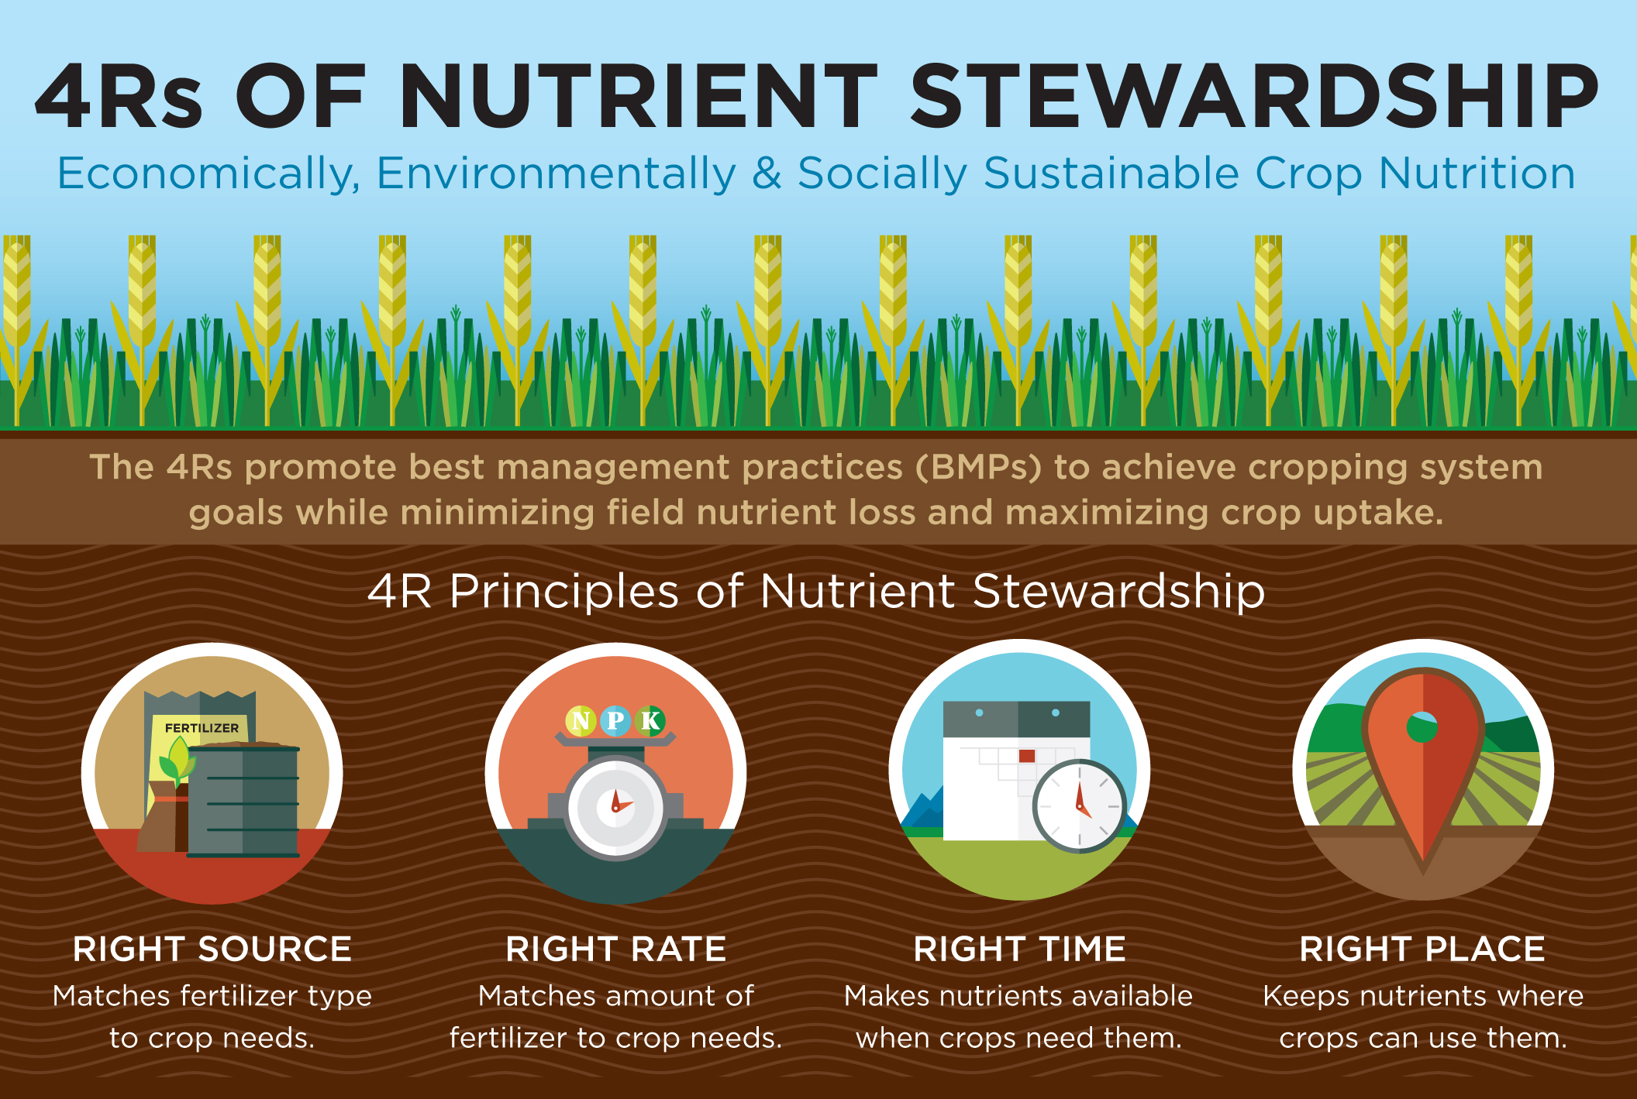
Simple Messaging Targets Producers

Slide 23
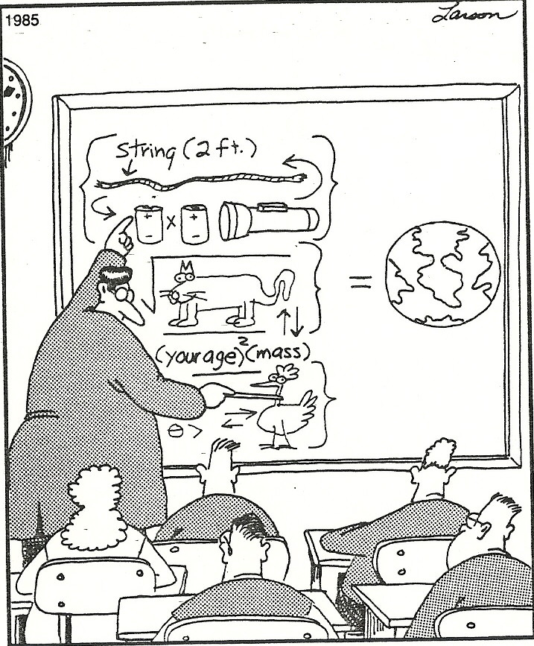
Do your part.
Make good decisions.
Thank you!
Questions?
Robb Meinen
Penn State
rjm134@psu.edu
(814) 865-5968

