Slide 1


Federal & State
Manure Application
Regulations
Trish Dunn
Fertilizer Control Specialist – Office of Indiana State Chemist

Slide 2
Write it down!!! Sign the attendance sheets!!!
Private applicators:
Certification = 5 years
3 PARP in 5 years. Attend 3 PARPs before expiration date on card.
No more than 2 PARP in 1 year
More than 3 PARP does not add credit
Keep your receipt
Notes:
Type the program number in the gold box, it is a text box.
Display this slide at beginning of program, and throughout the program as much as possible. Or print a paper copy if powerpoint is not used at PARP.

Slide 3

Federal Rule
40 CFR Part 122 & Part 412
National Pollutant Discharge Elimination System (NPDES)
  The NPDES program requires permits for the discharge of “pollutants” from any “point source” into “waters of the United States.”

Slide 4
Federal Rule
Large CAFO
  700 mature dairy cows, whether milked or dry
  1,000 veal calves
  1,000 cattle other than mature dairy cows or veal calves.
  2,500 swine each weighing 55 pounds or more
  10,000 swine each weighing less than 55 pounds
  500 horses
  10,000 sheep or lambs
  55,000 turkeys
  30,000 laying hens or broilers
  125,000 chickens
  82,000 laying hens
  30,000 ducks
  5,000 ducks

Slide 5
Federal Rule
Medium CAFO
  200 - 699 mature dairy cows, whether milked or dry
  300 - 999 veal calves
  300 – 999 cattle other than mature dairy cows or veal calves.
  750 - 2,499 swine each weighing 55 pounds or more
  3,000 – 9,999 swine each weighing less than 55 pounds
  150 – 499 horses
  3000 – 9,999 sheep or lambs
  16,500 - 54,999 turkeys
  9,000 – 29,999 laying hens or broilers
  37,500 - 124,999 chickens
  25,000 - 81,999 laying hens
  10,000 - 29,999 ducks
  1,500 - 4,999 ducks

Slide 6
Federal Rule
Best Management Practices (BMP)
  Nutrient Management Plan
  Determination of Application Rates
  Manure & Soil Sampling
  Inspect Land application equipment for leaks
  Application Setbacks
    100 feet from surface water, open tile, sinkholes, well head unless exercise compliance alternative.
      Compliance Alternative:
        Vegetative buffer
        Alternative Practices

Slide 7


Indiana - Two State Agencies
Indiana Department of Environmental Management (IDEM)
  Permitting & Enforcement for CFO & CAFOs
    Confined Feeding Operation (CFO)
    Concentrated Animal Feeding Operation (CAFO)
Office of Indiana State Chemist (OISC)
  Regulates Feed, Fertilizer, Seed & Pesticide
  2011 - Certification for CFO manure & For-hire
  2012 - Fertilizer Use (staging, application, & plan)

Slide 8
IDEM
Permitted CFO
  Three hundred (300) cattle;
  Six hundred (600) swine or sheep;
  Thirty thousand (30,000) fowl; or
  Five hundred (500) horses;
Annual Manure Analysis & Soil Sample every 4 years
No frozen/snow covered ground application unless emergency situation with prior notification.
Application setbacks depending on method

Slide 9
IDEM - CFO
Manure Application Rates
Phosphorus Application Rates for Large CAFOs Approved for Initial Construction After February 13, 2003, and CFOs Approved for Initial Construction After the Effective Date of this Article
Soil Test Level (ppm) | Application Rate
0-50 | N based
51-100 | 1.5 X P Crop Removal
101-200 | 1.0 X P Crop Removal
200+ | 0

Slide 10
IDEM → OISC
CFO manure requires a certification from OISC
CFO markets and distributes manure
Any person who uses (applies, handles, transports) 10 cubic yards or 4,000 gallons of any type of fertilizer material (manure, commercial fertilizer) is required to follow staging setbacks, have an application plan, and follow application setbacks (same as permitted CFOs).

Slide 11
Application/Nutrient Management Plan
Fertilizer Plan required by ALL growers.
  Required for both Manure (organic) and Inorganic Fertilizer applications
The Fertilizer Plan, at a minimum, is a WRITTEN plan that ties the application of fertilizer to agronomic rates.
Must include how fertilizer rates are determined.
The purpose is that you have thought about the rate to meet the crop’s need.
Notes:
Plan required by everyone who applies fertilizer materials – inorganic/commercial and manure/organic. Certified and not certified.
Both Manure (Organic) and Inorganic Fertilizer [what you buy from your ag retailer or distributor]. Liquid or solid fertilizer included as well as anhydrous ammonia)
Rule does not really specify what is in the plan except to mention how fertilizer rates are determined.
Think paragraphs, not plan.
Maybe manure sample, or standard replacement value of 1.2 pounds per bushel of corn removed, soil sampling, tri-state fertilizer recommendations, yield records
CFO is required to have manure analysis, non CFO does not. Recommend having analysis
A fertilizer plan is the grower’s defense against unpreventable acts of nature (storms, floods, etc).

Slide 12
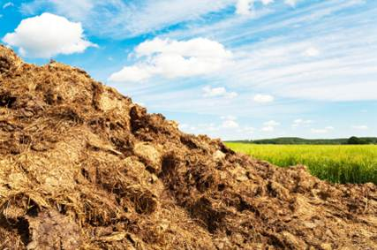
Staging
Staging is the temporary placement of product in a pile in preparation of field application. The fertilizer material is meant to be used now, rather than later.
Piles behind the barn are subject to IDEM Regulation and WILL BE in
violation if runoff
contaminates water and/or
leaves the property.
Notes:
Staging is IN the field. Piles behind the barn are not staging. Barn piles are exempt from staging restrictions.
Piles behind the barn may be subject to IDEM Regulation and WILL BE if runoff contaminates water.

Slide 13
Manure (Organic) Staging Restrictions
100 feet from property line and public road
400 feet from residential buildings
Do not place within 300 feet of surface water, drainage inlets or water wells
Manure cannot be staged on the side of a hill
Notes:
Restrictions of Staging Manure from CFO and non-CFO are Major Changes. The restrictions in Italics is the differences between staging of Inorganic and Manure.
Residential buildings where other people (not self) live.
These are IDEM CFO rules, now applicable to all manure applicators.
Civil penalty fine if not moved.

Slide 14
Manure (Organic) Staging Restrictions
Cannot place in standing water, a waterway or floodway
After 72 hours, the pile needs to be covered or bermed
Applied within 90 days
Notes:
These points are the similar to inorganic staging.

Slide 15
Fertilizer Material Application Restrictions
Cannot be applied directly to water
Cannot be applied from a public road
Cannot be applied to saturated ground
If you can get in the field, then it’s not saturated
No other application restrictions for Inorganic.
Notes:
Fertilizer Materials = Inorganic/commercial AND Manure/organic
Really Not Much of an Affect to Production Practices
Public Right-of-way is not Public Road
Saturated means soil soaked with moisture that it cannot absorb any more liquid e.g., standing water. Puddle in the field that can be driven through or around is exempt from saturation requirements.

Slide 16
Manure (Organic) Application Restrictions
Affects ANYONE applying manure.
 | Liquid Injection or Single-pass Incorporation of Liquid or Solid | Liquid Incorporation (within 24 hr) or Surface-applied Solid
Public Water Supply | 500 feet | 500 feet
Surface Waters | 25 feet | 50 feet
Sinkholes | 25 feet | 50 feet
Water Wells | 50 feet | 50 feet
Drainage Inlets | 5 feet | 50 feet
Property Lines | 0 feet | 10 feet
Public Roads | 0 feet | 10 feet
Notes:
These are the IDEM tables, but what’s new is that it applies to ALL manure applications – not just Category 14 certified applicators.
Credit for some application methods, and penalized for others Getting credit for the application with less application setbacks.
Liquid Injection: Liquid manure injected below ground.
Single Pass Incorporation: Is liquid or solid manure applicator and incorporation tool, pulled behind each other by same equipment.
Public Road NOT same as Public Right-of-way.

Slide 17
Manure (Organic) Application Restrictions
Watch out for property lines and wells
 | Surface-applied Liquid⎯ no incorporation or injection of manure
 | Less than 6% Slope or Residue Cover | Greater than 6% Slope
Public Water Wells | 500 feet | 500 feet
Surface Waters | 100 feet | 200 feet
Sink Holes | 100 feet | 200 feet
Water Wells | 100 feet | 200 feet
Drainage Inlets | 100 feet | 200 feet
Property Lines | 50 feet | 50 feet
Public Roads | 50 feet | 50 feet
Notes:
Penalties for applying it right on the surface and leaving it exposed to rain
If highly erodible ---
See next slide

Slide 18
Manure (Organic) Applications to
Frozen Ground or Snow Covered Ground
Cannot apply within 200 feet of surface water
Cannot apply within floodway
Can only represent up to 50% of the next crop
Cannot apply when slope is greater than 2% unless 40% crop residue or cover crop
Inorganic fertilizer
CAN be applied to
frozen ground
Notes:
50% Example: if N recommendation is 250 lb of N; then the maximum single application to snow/frozen ground is 125 lb.
In addition – the general application setbacks apply

Slide 19
For more information
OISC
765 494 1492
www.oisc.purdue.edu
Or Trish
765-494-0579
pwaller@purdue.edu

Slide 20
Illinois
Comeback at 1:00 PM for David Ginder’s presentation.
Applications within ¼ mile of any residence not part of the facility must be injected or incorporated on the day of application UNLESS operation was in existence prior to May 21,1996 and is applying via irrigation or this existing facility is applying waste on frozen ground.
Manure may not be applied within 200’ of surface water unless the water is upgrade or there is adequate diking.
Manure may not be applied within 150’ of potable water supply wells. (200’ setback requirement for NRCS and EPA.)
Manure may not be applied in a 10-year flood plain UNLESS manure is injected or incorporated.
Manure may not be applied in grass waterways.

Slide 21
Michigan
Generally Accepted Agricultural & Management Practices (GAAMPs)
  Soil Sample
  Use current fertilizer recommendations
  Manure analysis
  Manures should not be applied to soils within 150 feet of surface waters or to areas subject to flooding unless:
    (a) manures are injected or surface-applied with immediate incorporation (i.e., within 48 hours after application) and/or
    (b) conservation practices are used to protect against runoff and erosion losses to surface waters.
  Avoid frozen or snow covered applications.

Slide 22
Minnesota
Manure Analysis required for facilities with 100+ animal units
Limited to Nitrogen availability and removal
Soil sample every 4 years for soils receiving manure from 300+ animal units.
Nutrient Management Plan
  NPDES facilities
  300+ animal units
Open Tile Intakes
  Within 300 feet must be injected or incorporated within 24 hours
Sinkhole/mines/quarries
  No application within 50 feet; must be incorporated within 24 hours if within 300 feet

Slide 23
Ohio
Follow standards from "Field Office Technical Guide”
Distressed water sheds:
  No application between December 15th – March 1st
  No surface application to frozen ground of snow covered with 1” or more.
  No surface application if a greater than 50% chance of precipitation exceeding ½” for 24 hours.
Western Lake Erie
  No application to frozen/snow covered ground
  No application if top 2” soil saturated
  No surface application if a greater than 50% chance of precipitation exceeding ½” for 24 hours.

Slide 24
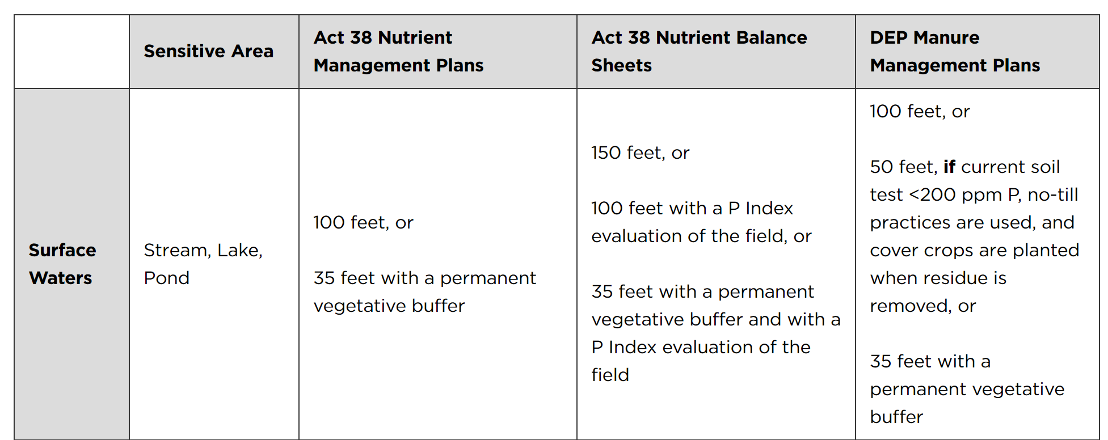
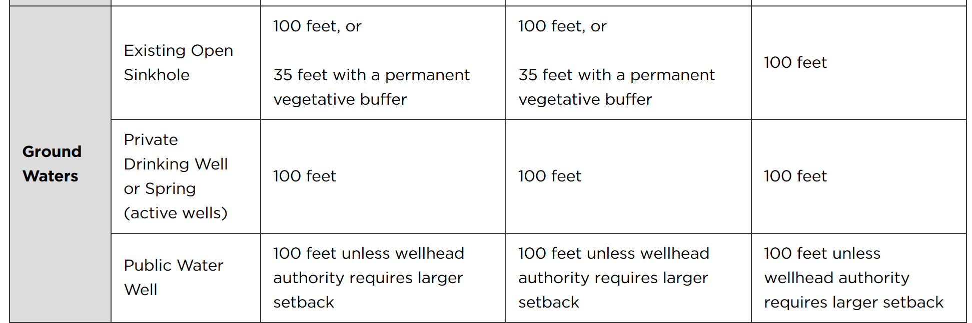
Pennsylvania

Slide 25
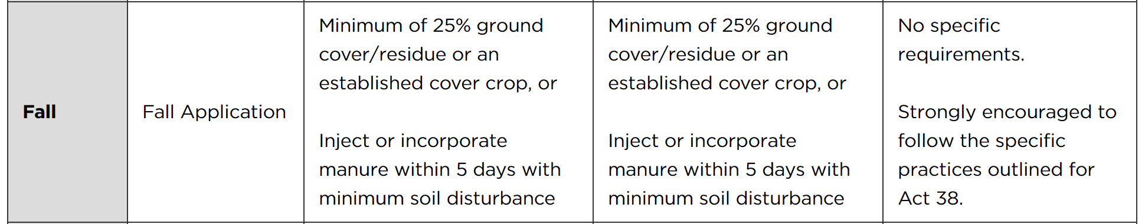
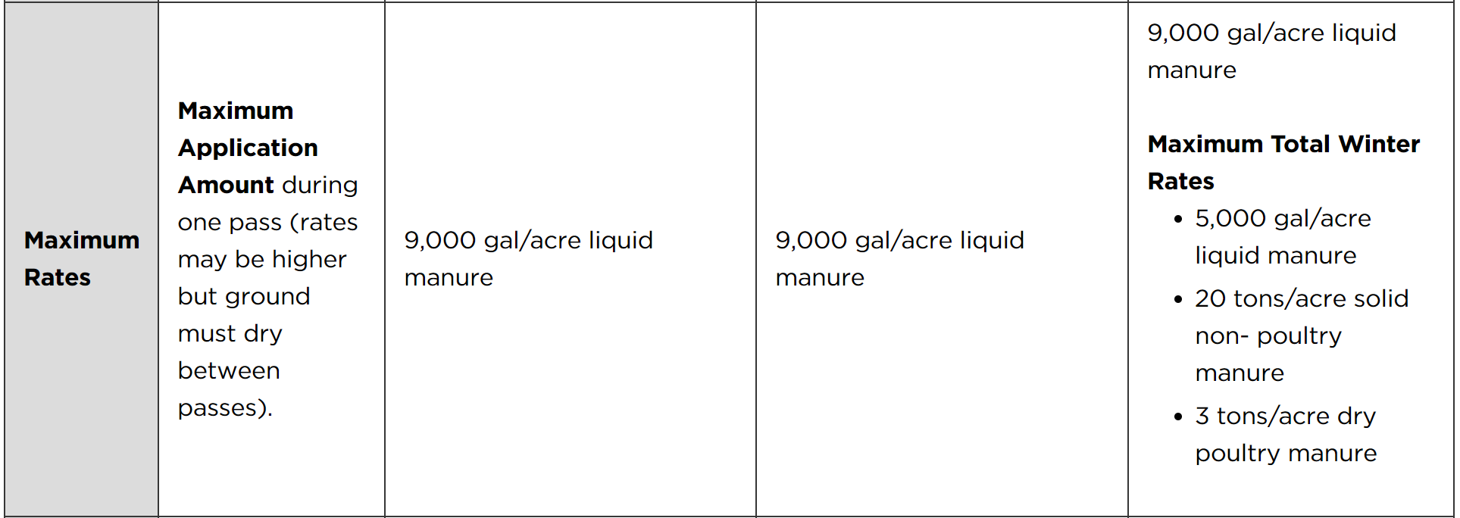
Pennsylvania

Slide 26
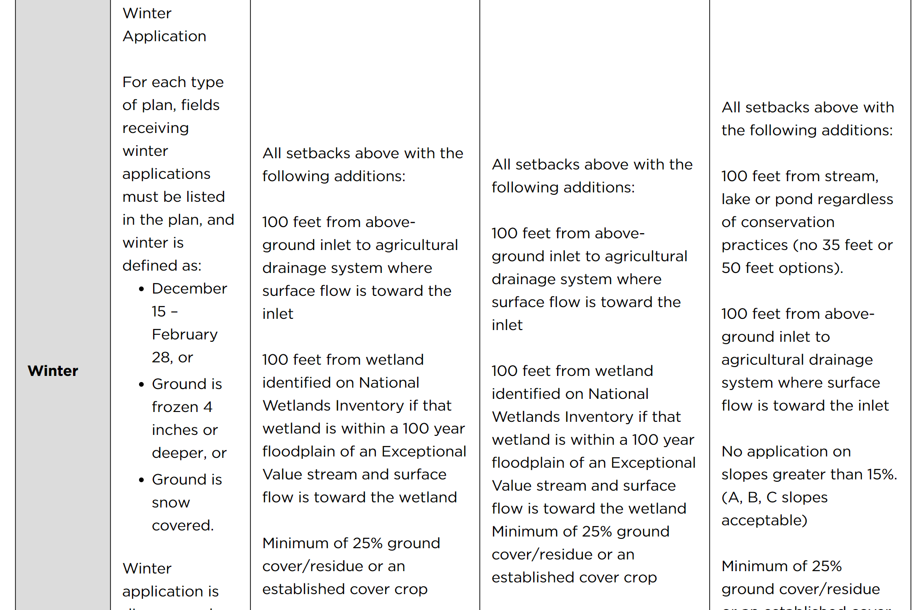
Pennsylvania

Slide 27
Wisconsin
No ponding on the application site or off the application site.
Do not contaminate water in a well.
Do not apply manure or process wastewater to saturated soils.
Manure or process wastewater may not be applied on areas of a field with a depth to groundwater or bedrock of less than 24 inches.
Manure or process wastewater may not be applied within 100 feet of a direct conduit to groundwater.
Manure or process wastewater may not be applied within 100 feet of a private well or non-community system or within 1000 feet of a community well.
Soils that are 60 inches thick or less over fractured bedrock, manure or process wastewater may not be applied on frozen ground or where snow is present.
Manure or process wastewater may not be applied on fields when snow is actively melting such that water is flowing off the field.
Where incorporation of land applied manure is required under NRCS Standard 590, the incorporation shall occur within 48 hours of application.
Manure or process wastewater may not be surface applied when precipitation capable of producing runoff is forecast within 24 hours of the time of planned application.

Slide 28
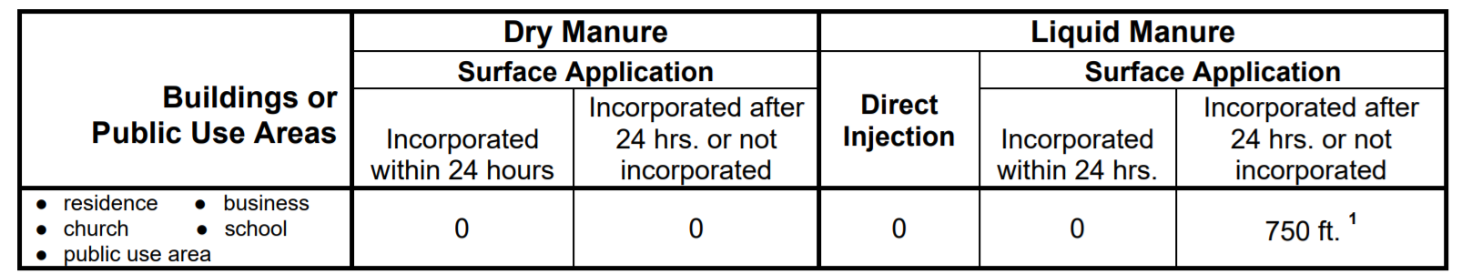
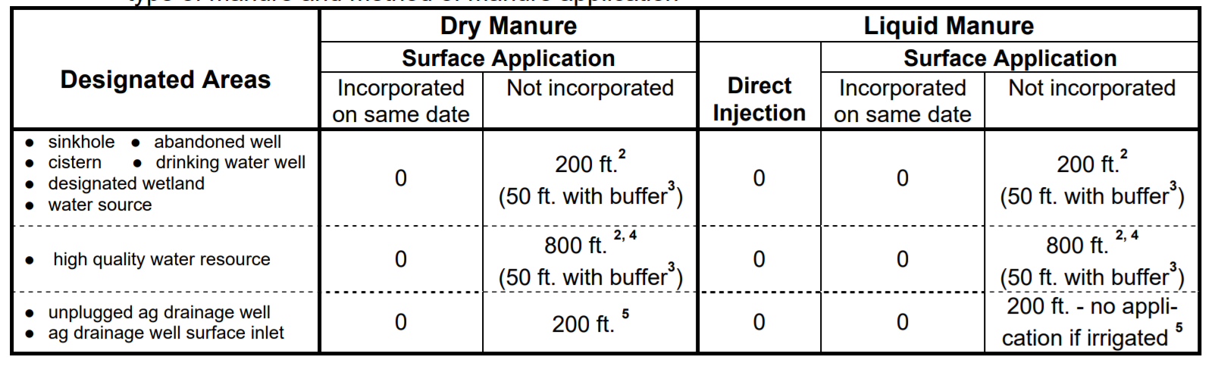
Iowa
Confinement & OpenFeed lot

Slide 29
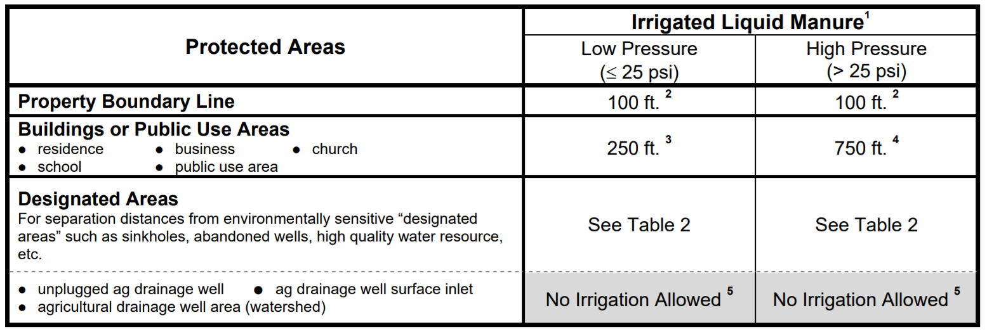
Iowa
Recommended, but not required: avoid application within 200 feet of (and draining into) a surface intake for a tile line.

Slide 30
Write it down!!! Sign the attendance sheets!!!
Private applicators:
Certification = 5 years
3 PARP in 5 years. Attend 3 PARPs before expiration date on card.
No more than 2 PARP in 1 year
More than 3 PARP does not add credit
Keep your receipt
Notes:
Type the program number in the gold box, it is a text box.
Display this slide at beginning of program, and throughout the program as much as possible. Or print a paper copy if powerpoint is not used at PARP.

